Slide 1
Absorption, Distribution, Metabolism and Excretion (ADME):
NST110: Advanced Toxicology
Lecture 2: Absorption and Distribution

Slide 2
Review and Forward
The toxicity of a substance depends on the dose.
However, it is ultimately not the dose but the concentration of a toxicant at the site of action (target organ or tissue) that determines toxicity.
The concentration of a chemical at the site of action is often proportional to the dose, but the same dose of two or more chemicals may lead to vastly different concentrations in a particular target organ of toxicity depending on the disposition of the chemical.
Disposition of a chemical depends on absorption, distribution, biotransformation (metabolism) and excretion.

Slide 3
Biological Factors that Determine Toxicity
Exposure to chemical
absorption
Protein binding
Free form
Bound form
translocation
Storage sites
Biotransformation
sites
Toxic sites
metabolism
Toxic
action
Excretion sites
toxicity

Slide 4
Absorption
Factors involved in absorbing a chemical:
  Physicochemical properties of your chemical
    Hyrdrophobic? Hydrophilic?
    Ionized? Nonionized? Weak acid/base?
    Molecular weight? Volatility?
  Route of exposure
  Getting chemicals across cell membranes
    Diffusion/Passive transport
    Active transport

Slide 5
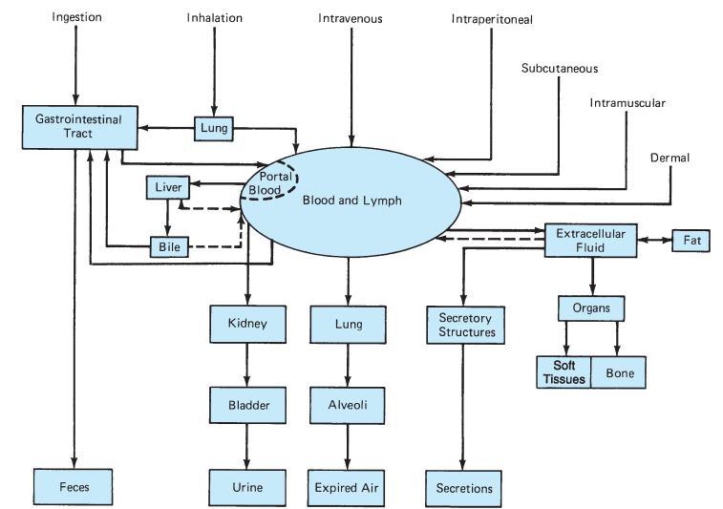
Routes of Absorption, Distribution and Excretion
Routes of Absorption:
Ingestion
Inhalation
Dermal
Inhalation
Intravenous
Intraperitoneal
Intramuscular
Subcutaneous
Routes of Distribution:
Systemic circulation
Portal circulation
Lymphatic system
Fat
Extracellular fluid
Organs
Routes of Excretion:
Feces
Urine
Expired air
secretions

Slide 6
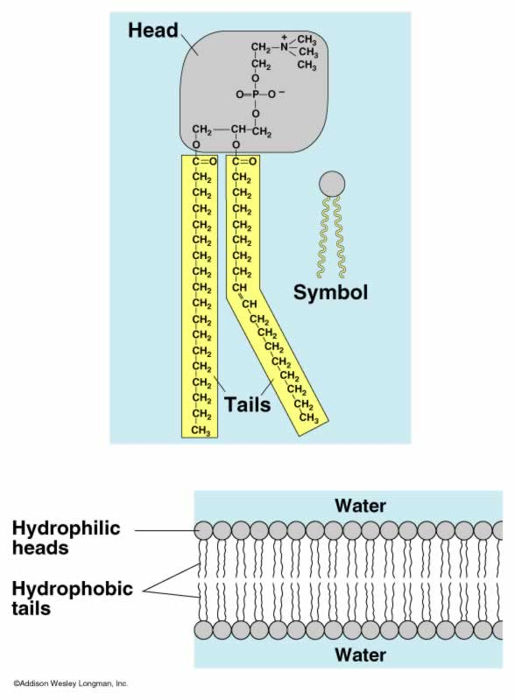
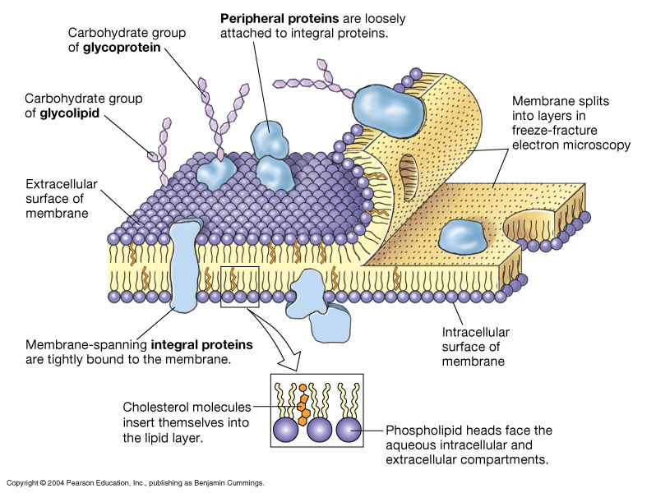
Absorption Across Membranes
Polar head: choline, serine, ethanolamine, inositol
phosphate
Glycerol backbone
2 nonpolar fatty acids
The membrane is a phospholipid bi-layer consisting of a polar head group, phosphate, glycerol backbone and 2 fatty acid molecules esterified to the glycerol backbone.
hydrophobic compounds can diffuse across the membrane
hydrophilic compounds will not diffuse across the membrane

Slide 7
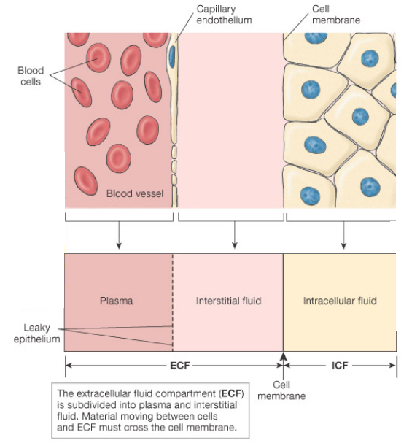
Physical Barriers to Absorption

Slide 8
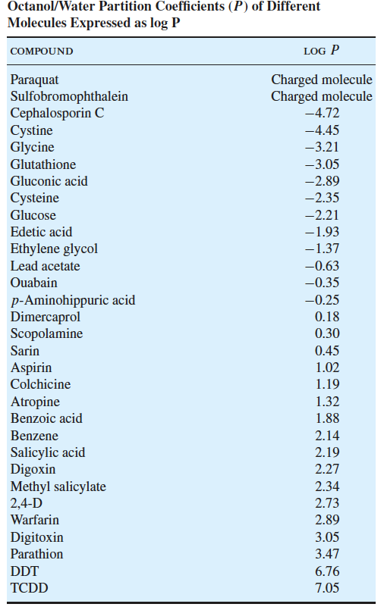
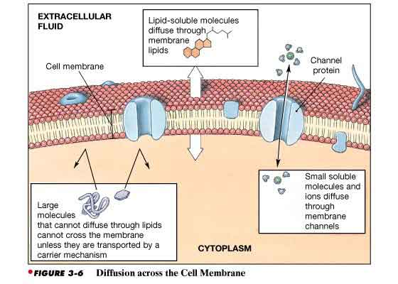
Types of Transport
Passive Diffusion—no ATP required; gradient driven
a. Simple Diffusion—hydrophobic molecules passively diffuse across the membrane. Rate of transport proportional to the octanol/water partition coefficient or logP.
b. Facilitated Diffusion—saturable carrier-mediated transport (e.g. glucose transporter)

Slide 9
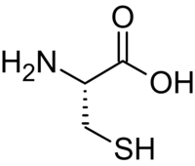
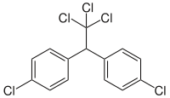

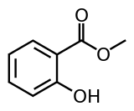

Simple Diffusion Based on LogP
Dichlorodiphenyltrichloroethane (DDT) (6.7)
Cysteine (-2.2)
Glucose (-2.2)
Methyl salicylate (2.19)

Slide 10
Simple Diffusion of Weak Organic Acids and Bases
The ionized form usually has low lipid solubility and does not permeate readily through the lipid domain of a membrane.
The non-ionized form of weak organic acids and bases is more lipid soluble, resulting in diffusion across the lipid domain of the membrane.
The pH at which a weak organic acid or base is 50 % ionized is its pK_{a} or pK_{b}.

Slide 11
The degree of ionization of a chemical depends on its pKa and on the pH of the solution, a relationship described by the Henderson-Hasselbalch equation.
For acids: pK_{a} – pH= log [non-ionized]/[ionized]
For bases: pK_{b} – pH=log [ionized]/[non-ionized]
pK_{a} of benzoic acid = 4.0; pK_{b} of aniline = 5.0
Notes:
Note: pKa of RNH3+ = 10-11, R2NH2+ = 11

Slide 12
pH Effect: Acid/Base effect on absorption
pH
i.e. pH ~2 stomach
R-CO₂H would be absorbed under acidic conditions (e.g. stomach).
R-NH₂ would be absorbed at neutral pH (e.g. intestine, nasal passage).
pH
i.e. pH ~7.4 intestine, nasal passage

Slide 13
Compounds will accumulate in total amount where there are more binding sites
Applicable for the blood-brain barrier; toxicants with high affinity for binding proteins (e.g. albumin, hemoglobin) less likely to cross barrier.

Slide 14
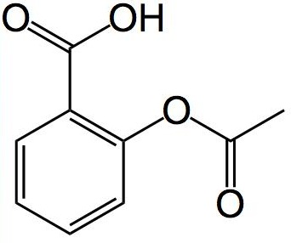
What are the common names for these chemicals and where are they likely to be absorbed?
CH₃

Slide 15
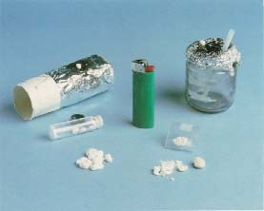
Freebasing
CH₃
CH₃
Freebasing has been done with baking soda (sodium bicarbonate) or ammonia (NH₃) to increase absorption of cocaine (crack) via nasal installation.

Slide 16
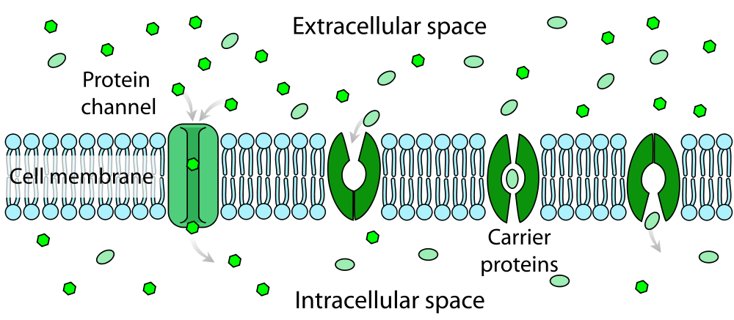
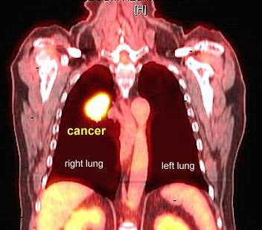
Facilitated Diffusion
Facilitated Diffusion—saturable carrier-mediated transport (e.g. glucose transporter)
Glucose
(taken up by glucose transporters by facilitated diffusion)
2-deoxy-glucose
(also taken up by glucose transporters—inhibits hexokinase--chemotherapeutic)
Fluorodeoxyglucose
(taken up by glucose transporters—imaging agent for tumors)

Slide 17
2. Active Transport--a) chemicals are moved against an electrochemical gradient; b) the transport system is saturable; c) requires the expenditure of energy.
Examples:
  multi-drug-resistant protein (mdr)—decreases GI absorption, blood-brain barrier, biliary excretion, placental barrier
  Multi-resistant drug protein (mrp)—urinary excretion, biliary excretion
  Organic-anion transporting polypeptide (oatp)—hepatic uptake of organic anions
  Organic anion transporter (oat)—kidney uptake of organic anions
  Organic cation transporter (oct)—kidney, liver and placental uptake of organic cations
  Divalent-metal ion transporter (dmt)—GI absorption of divalent metals (Fe²⁺,
  Cu ²⁺, Mg²⁺, etc.)
  7. Peptide transporter (pept)—GI absorption of peptides

Slide 18
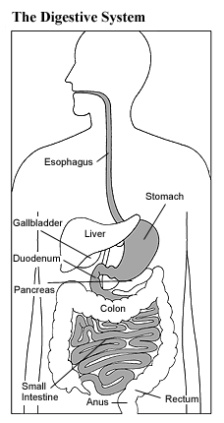
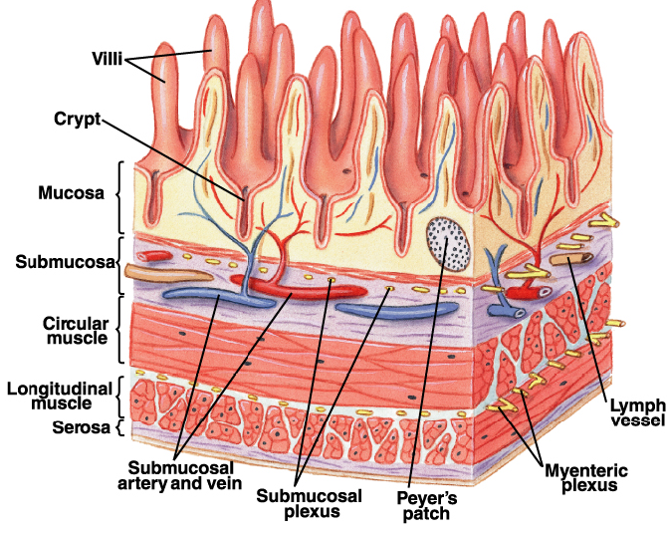
Routes of Exposure: Oral (GI tract)
GI tract can be viewed as a tube traversing the body.
Although the GI tract is in the body, its contents can be considered exterior to most of the body’s metabolism.
Unless the toxicant is an irritant or has caustic properties, poisons in the GI tract do not produce systemic injury until absorbed.
Absorption can occur anywhere in the GI tract including the mouth and rectum.
Initial metabolism can
occur in gastric cells.

Slide 19
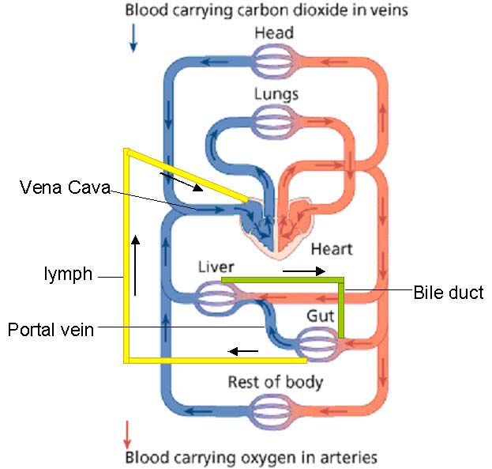
GI Tract Absorption
Weak acids and bases will be absorbed by simple diffusion to a greater extent in the part of the GI tract in which they exist in the most lipid-soluble (non-ionized) form—hydrophilic substances will be transported to the liver by the portal vein
Highly hydrophilic substances may be absorbed through transporters (xenobiotics with similar structures to endogenous substrates).
Highly hydrophobic compounds may be absorbed into the lymphatic system via chylomicrons and drained into venous circulation near the heart.
The greatest level of absorption for most ingested substances occurs in the small intestine.

Slide 20
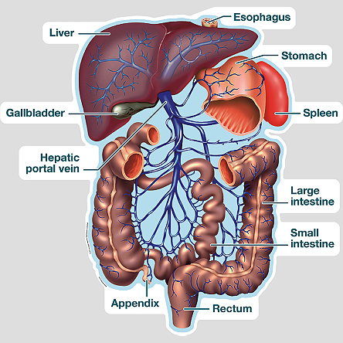
Polar versus Nonpolar GI Absorption
Polar substances that are absorbed:
go to the liver via the portal vein.
may undergo first-pass metabolism or presystemic elimination in gastric and/or liver cells where xenobiotics may be biotransformed.
can be excreted into the bile without entrance into the systemic circulation or enter the systemic circulation.
The liver and first-pass metabolism serve as a defense against most xenobiotics. The liver is the organ with the highest metabolic capacity for xenobiotics.

Slide 21
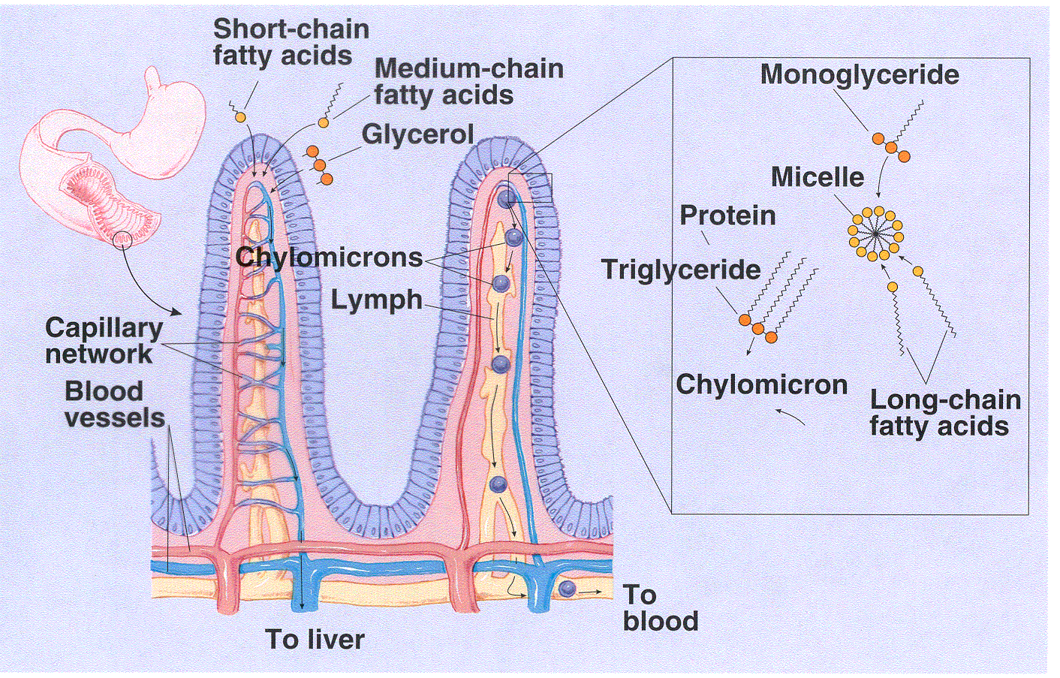
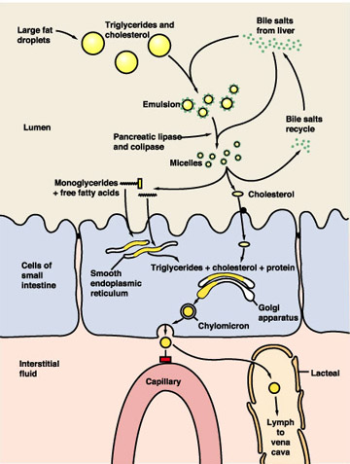
Polar versus Non-Polar GI Absorption
Lipophilic, non-polar substances (e.g. polycyclic aromatic hydrocarbons)
Ride on the “coat-tails” of lipids via micelles and follow lipid absorption to the lymphatic system (via chylomicrons) to the lungs.
2. Non-polar substances may by-pass first-pass metabolism. e.g. PAH have selective toxicity in the lung, where they may be metabolically activated.

Slide 22
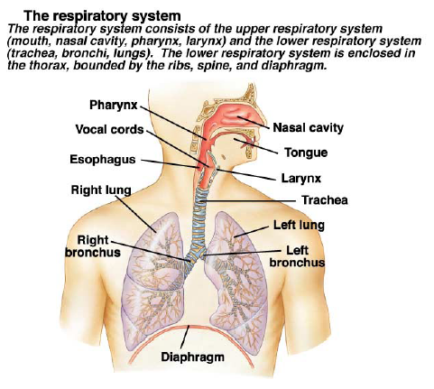
Routes of Exposure: Inhalation (Lung)
Toxicants absorbed by the lung are:
  Gases (e.g. carbon monoxide, nitrogen dioxide, sulfur dioxide, phosgene)
  Vapors or volatile liquids (e.g. benzene and carbon tetrachloride)
  Aerosols

Slide 23
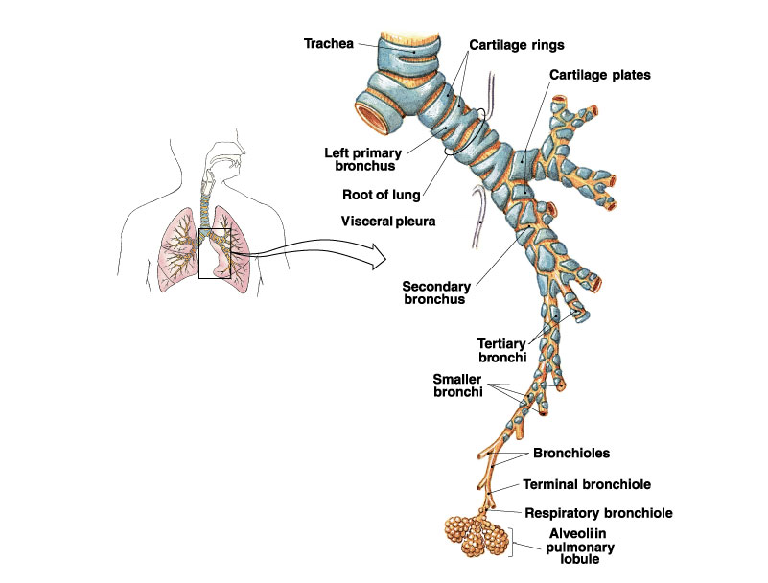

Slide 24
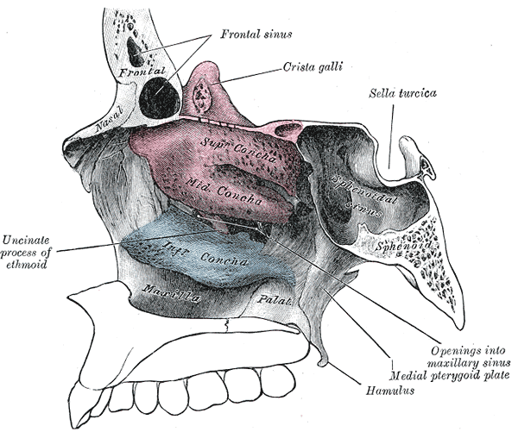
Gases and Vapors
The absorption of inhaled gases and vapors starts in the nasal cavity which has:
Turbinates, which increase the surface area for increased absorption (bony projections in the breathing passage of the nose improving smell).
Mucosa covered by a film of fluid.
3. The nose can act as a “scrubber” for water-soluble gases and
highly reactive gases, partially protecting the lungs from
potentially injurious insults (e.g. formaldehyde, SO₂).
-Rats develop tumors in the nasal turbinates when exposed to formaldehyde.

Slide 25
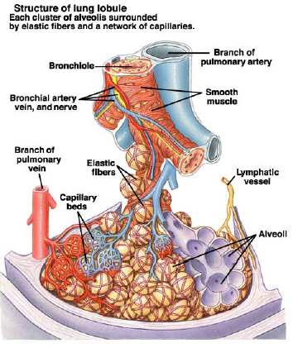
Absorption of Gases
Absorption of gases differs from intestinal and percutaneous absorption of compounds because:
  1. Ionized molecules are of very low volatility, so their ambient air concentration is insignificant.
  2. Epithelial cells lining the alveoli (type I pneumocytes) are very thin and the capillaries are in close contact with the pneumocytes, so the diffusion distance is very short.
3. Chemicals absorbed by the lungs are rapidly removed by the blood (3-4 seconds for blood to go through lung capillary network).

Slide 26
When a gas is inhaled into the lungs, gas molecules diffuse from the alveolar space into the blood and then dissolve.
The gas molecules partition between the air and blood during the absorptive phase, and between blood and other tissues during the distributive phase.
Note that inhalation bypasses first-pass metabolism.

Slide 27
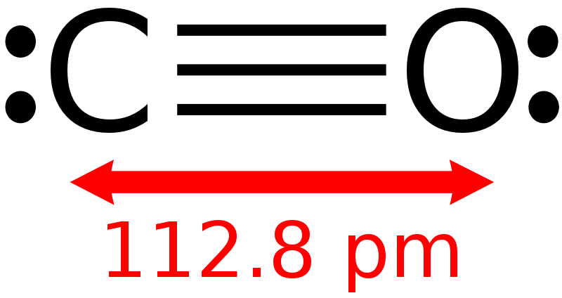
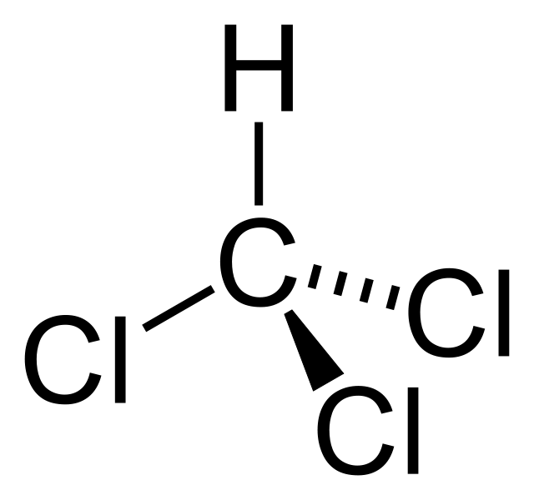
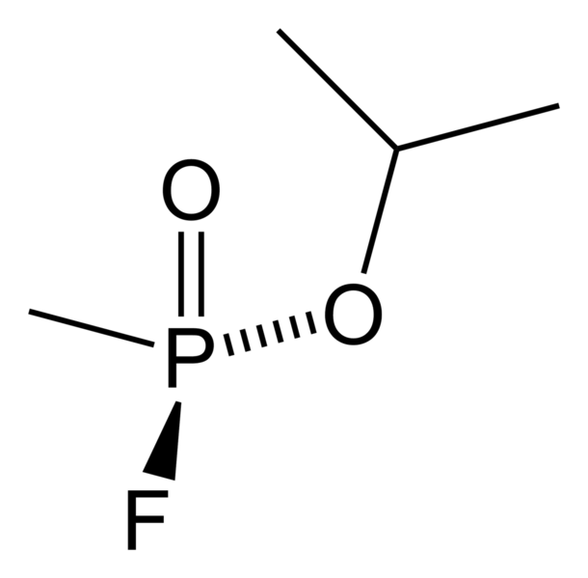
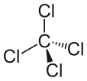

Examples of Toxicant Gases or Volatile Liquids
Carbon monoxide—binds hemoglobin (with >200x affinity compared to O2) and displaces oxygen leading to impaired oxygenation of tissues, energy impairment, and death
Chloroform—anesthetic that depresses the nervous system, but can also be metabolized to phosgene, a reactive metabolite that modifies proteins and causes toxicity in lung, kidney, and liver.
Sarin gas—chemical warfare agent (recently used in Syria) that causes excessive neuronal excitation, convulsions, seizures, tearing, salivation, suffocation, and death through inhibition of acetylcholinesterase
Carbon tetrachloride—volatile liquid used widely as a cleaning agent and refrigerant, currently banned—greenhouse gas and carbon tetrachloride can be bioactivated in the liver to produce a potent hepatotoxin
Benzene—largely found in crude oil, but also found in tobacco smoke and used to be found in glues, paints, and detergents—benzene metabolism leads to bioactivated carcinogens that cause leukemia

Slide 28
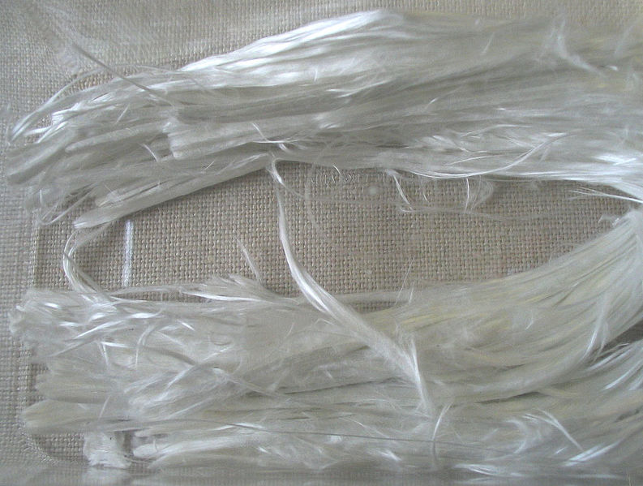
Aerosols and Particles
Size Location of Absorption
>5 μm Deposited in nasopharyngeal region (or mouth).
1. Removed by nose wiping, blowing or sneezing.
2. The mucous blanket of the ciliated nasal surface can propel insoluble particles by movement of cilia and be swallowed.
3. Soluble particles can dissolve in mucus and be carried to the pharynx or nasal epithelia and into blood. (asbestos-lung cancer)
2-5 μm Deposited in tracheobronchiolar regions of the lungs.
1. Cleared by retrograde movement of mucus layer in ciliated portion of respiratory tract.
2. Coughing can increase expulsion rate.
3. Particles can be swallowed and absorbed from the GI tract. (asbestosis—lung fibrosis, wheezing)
<1 μm Penetrates to alveolar sacs of lungs and is absorbed into blood or cleared through lymphatic system after being scavenged by alveolar macrophages. (asbestos and silica dust can cause silicosis—cough, shortness of breath, inflammation, immunodeficiency through damaging pulmonary macrophages)

Slide 29
Pulmonary Clearance
Particles trapped in fluid layer of conducting airway removed by mucociliary escalator.
Particles phagocytized by alveolar macrophages removed by lymph.
Substances dissolved from particle surface removed in blood.
Small particles directly penetrate epithelial membranes.

Slide 30
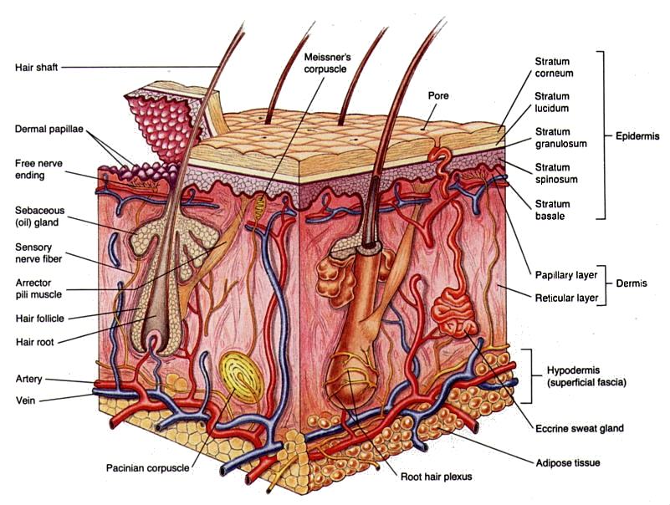
Routes of Exposures: Dermal (skin)
Human skin comes into contact with many toxic agents. Fortunately, the skin is not very permeable and is a good barrier for separating organisms from their environment.

Slide 31
Factors for Dermal Absorption
To be absorbed through the skin, a toxicant must pass through the epidermis or the appendages (sweat and sebaceous glands and hair follicles).
Once absorbed through the skin, toxicants must pass through several tissue layers before entering the small blood and lymph capillaries in the dermis.

Slide 32
•The rate-determining barrier in the dermal absorption of chemicals is the epidermis—especially the stratum corneum (horny layer), the upper most layer of the epidermis.
The cell walls are chemically resistant, two-times thicker than for other cells and dry, and in a keratinous semisolid state with much lower permeability for toxicants by diffusion—the stratum corneum cells have lost their nuclei and are biologically inactive (dead).
Once a toxicant is absorbed through the stratum corneum, absorption through the other epidermal layers is rapid.

Slide 33
All toxicants move across the stratum corneum by passive diffusion
Polar substances diffuse through the outer surface of protein filaments of the hydrated stratum corneum.
Non-polar molecules dissolve and diffuse through the lipid matrix between protein filaments.
The rate of diffusion is proportional to lipid solubility and inversely proportional to molecular weight.
Once absorbed, the toxicant enters the systemic circulation by-passing first-pass metabolism.

Slide 34
Factors that Affect Stratum Corneum Absorption of Toxicants
Hydration of the stratum corneum
The stratum corneum is normally 7% hydrated which greatly increases permeability of toxicants. (10-fold better than completely dry skin)
On additional contact with water, toxicant absorption can increase by 2- to 3-fold.
2. Damage to the stratum corneum
Acids, alkalis and mustard gases injure the epidermis and increase absorption of toxicants.
Burns and skin diseases can increase permeability to toxicants.
3. Solvent Administration
Carrier solvents and creams can aid in increased absorption of toxicants and drugs (e.g. dimethylsulfoxide (DMSO)).

Slide 35
Special Routes of Exposure
Toxicants usually enter the bloodstream after absorption through the skin, lungs or GI tract. Special routes include:
1. Subcutaneous injection (SC) (under the skin)
  -by-passes the epidermal barrier, slow absorption but directly into systemic circulation; affected by blood flow
  2. Intramuscular injection (IM) (into muscle)
  -slower absorption than IP but steady and directly into systemic circulation; affected by blood flow
  3. Intraperitoneal injection (IP) (into the peritoneal cavity)
  -quick absorption due to high vascularization and large surface area
  -absorbed primarily into the portal circulation (to liver—first-pass metabolism) as well as directly into the systemic circulation.
4. Intravenous injection (IV) (into blood stream) -directly into systemic circulation

Slide 36
Toxicity is Dependent on Route of Exposure
Often, if a toxicant undergoes first-pass metabolism, it will be less toxic if administered orally than IV.
More toxic Less toxic
IV > Inhalation > IM/SC > Dermal > IP > Oral
No first-pass metabolism
Directly into systemic circulation
First-pass metabolism
(metabolized in the liver first)
Caveat: This does not apply for toxicants that have selective toxicity towards the GI tract or the liver, or for toxicants that become selectively bioactivated in the liver.

Slide 37
Summary on Absorption
Route of exposure and physicochemical properties of xenobiotic determine how a chemical is absorbed and whether it goes through first-pass metabolism or is subjected to systemic circulation.
The degree of ionization and the lipid solubility of chemicals are very important for oral and percutaneous exposures.
For exposure to aerosols and particles, the size and water solubility are important.
For dermal absorption, polarity, molecular weight and carrier solvent of the toxicant and hydration of the epidermis are important.

Slide 38
Distribution
After a toxicant enters portal circulation, systemic circulation, or lymph, it is available for distribution (translocation) throughout the body, which usually occurs very rapidly. The rate of distribution to organs or tissues is determined by:
Physicochemical properties of the chemical
Blood flow
Rate of diffusion out of the capillary bed into the cells of a organ or tissue.
Affinity of a xenobiotic for various tissues.
Penetration of toxicants into cells or tissues occurs by passive diffusion or active transport (as discussed earlier).

Slide 39
Physical Barriers to Distribution

Slide 40
Distribution of toxicants
Distribution can be highly localized, restricted or disperse depending on:
Binding and dissolution into various storage sites (fat, liver, bone)
Permeability through membranes
Protein binding
Active transport
If the toxicant accumulates at a site away from a toxic site of action, it is considered as a protective storage site

Slide 41
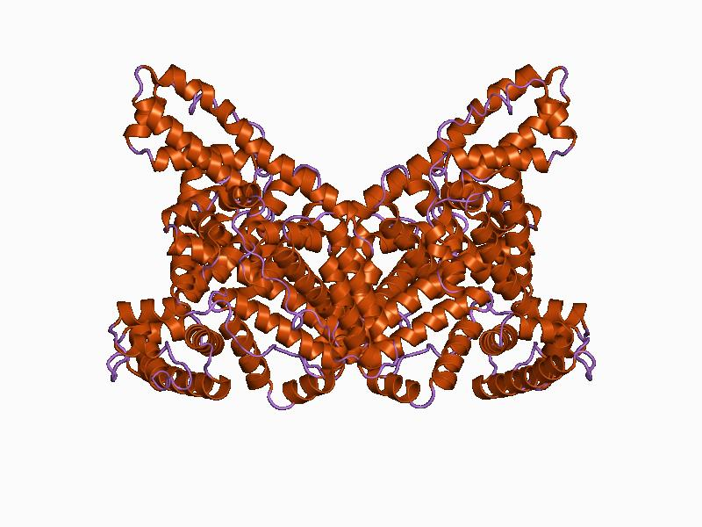
Storage of Toxicants in Circulation and Tissues
Plasma Proteins as Storage Depot:
  a. Albumin -the most abundant protein in plasma- can bind to a very large number of different compounds—(e.g. bilirubin, Ca²⁺, Cu²⁺, Zn²⁺, vitamin C, fatty acids, digitonin, penicillin, sulfonamides, histamine, barbiturates, thyroxine, etc.)
    Contains 6 binding regions on the protein
    Protein-ligand interactions occur primarily through hydrophobic forces, hydrogen bonding, and van der Waals forces.
    Bilirubin, a heme byproduct, is neurotoxic at high levels, but is normally bound to albumin to make it less toxic.

Slide 42
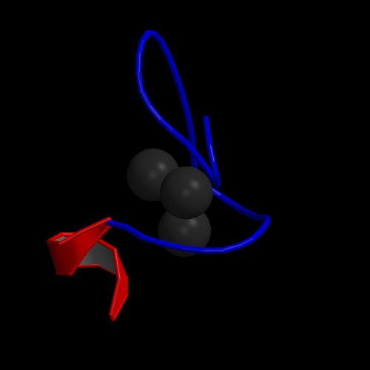
2. Liver and Kidney as Storage Depots—have the highest capacity for binding chemicals.
1. Ligandin: this cytoplasmic protein in the liver is a high-affinity binding protein for many organic acids—can bind bilirubin, azodye carcinogens, steroids, etc.
2. Metallothionein: found in the kidney and liver and has high affinity for cadmium and zinc--in the liver, metallothionein binds Lead (Pb) and concentrates it to 50-fold more than plasma.
Human metallothionein bound to Cd2+ determined by NMR

Slide 43
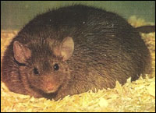
3. Fat as a Storage Depot
Many highly lipophilic toxicants are distributed and concentrated in fat (e.g. dioxin, DDT, polychlorinated biphenyls)
-The LD₅₀ of a fat-stored compound will be higher in an obese subject.
-However, a quick weight-loss can result in large release of toxicant and toxic effect.

Slide 44
4. Bone as Storage Depot
1. Compounds such as fluoride, lead, and strontium may be incorporated and stored in bone matrix.
2. 90% of lead in the body is eventually found in the skeleton.
3. The mechanism of storage is through exchange of bone components for the toxicant (e.g. F⁻ may displace –OH; Pb²⁺ and Sr²⁺ may substitute for Ca²⁺ in the hydroxyapatite lattice matrix).

Slide 45
Effects of Storage on Toxicity
Reduces toxicity of some substances by taking toxic substances out of the sites of action.
Increases toxicity if: a)toxicity at storage site, b) displacement of one substance by another (e.g. bilirubin), loss of storage site.
Can produce chronic toxicity from prolonged exposure.

Slide 46
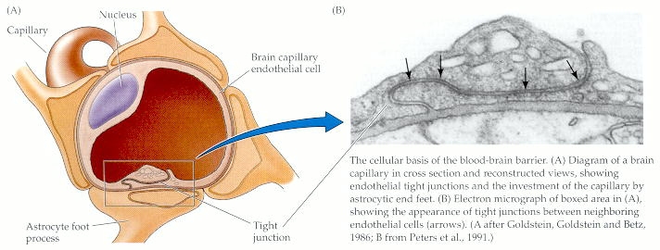
Blood-Brain Barrier
The blood-brain barrier serves to restrict access to many toxicants. It is not an absolute barrier.
It is a site that is less permeable to more hydrophilic substances than are most other areas of the body.

Slide 47
There are four major anatomic and physiologic reasons why some toxicants do not readily enter the CNS.
Capillary endothelial cells of the CNS are tightly joined, leaving few or no pores between cells.
Brain capillary endothelial cells contain an ATP-dependent transporter, the multi-drug-resistant (mdr) protein that transports some chemicals back into the blood.
Capillaries in the CNS are surrounded by glial cells (astrocytes) to further restrict access.
The protein concentration in the interstitial fluid of the CNS is much lower than in other body fluids.

Slide 48
Blood Brain Barrier
For water-soluble molecules, the tighter junctions of the capillary endothelium and the lipid membranes of the glial cells represent the major barrier.
Many lipid soluble compounds are restricted due to the many lipid membranes to be crossed (capillary and glial cell membranes) and low protein content.
The blood-brain barrier is more effective against water soluble substances.

Slide 49
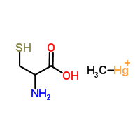
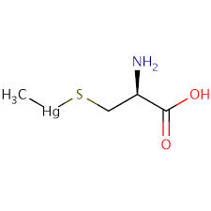
Methyl Mercury Transport Across the Blood-Brain Barrier
cysteine
Methyl mercury
Methyl
Mercuric cysteine
Methylmercury combines with cysteine, forming a structure similar to methionine, which is transported across the blood brain barrier through the methionine transporter in endothelial cells
Once in the brain, methyl mercuric cysteine can react with reactive cysteines on proteins and cause neurotoxicity

Slide 50

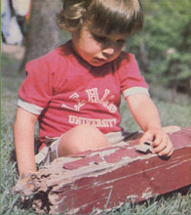
Children are more susceptible to neurotoxicants
The blood-brain barrier is not fully developed at birth, and this is one reason why some chemicals are more toxic in newborns than adults.
  Morphine is 3-10 times more toxic to newborns than adult rats because of higher permeability into the brain.
  Lead produces toxicity in the brain and spinal cord (encephalomyelopathy) in newborn rats but not in adults, because of differences in the stages of development of the blood brain barrier.

Slide 51
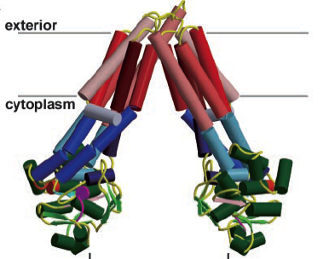
Family of ATP Binding Cassette (ABC) Proteins
The ATP-binding cassette (ABC) transporters form a large family of membrane proteins that transport a variety of compounds through the membrane against a concentration gradient at the cost of ATP hydrolysis.
Substrates include lipids, bile acids, xenobiotics, and peptides for antigen presentation. As they transport exogenous and endogenous compounds, they reduce the body load of toxicants.
One by-product of such protective function is that they also eliminate various useful drugs from the body, causing drug resistance. Many types of cancer cells can up-regulate MDR (multidrug resistant).
MRP1 (multi-resistant protein) was originally cloned from a lung tumor cell.

Slide 52
Three subfamilies of the human ABC family based on motifs in ATP binding domains:
ABCB1 (MDR1/P-glycoprotein of subfamily (hydrophobic and cationic compounds)
ABCC (MRPs) (phase II conjugate metabolites)
ABCG2 (phase II conjugates)
Xenobiotic substrates:
Alkaloids (bases)
Metals—arsenic, oxidized GSH (GSSG)
Conjugates of glutathione, glucuronic acid, and sulfates
Neutral compounds (e.g. PAH)

Slide 53
