Slide 1
Introduction
Apoptosis, or programmed cell death, is a highly regulated process that allows a cell to self-degrade in order for the body to eliminate unwanted or dysfunctional cells. During apoptosis, the genome of the cell will fracture, the cell will shrink and part of the cell will disintegrate into smaller apoptotic bodies.
Between 50 and 70 billion cells die each day due to apoptosis in the average human adult. For an average child between the ages of 8 and 14, approximately 20 billion to 30 billion cells die a day.

Slide 2
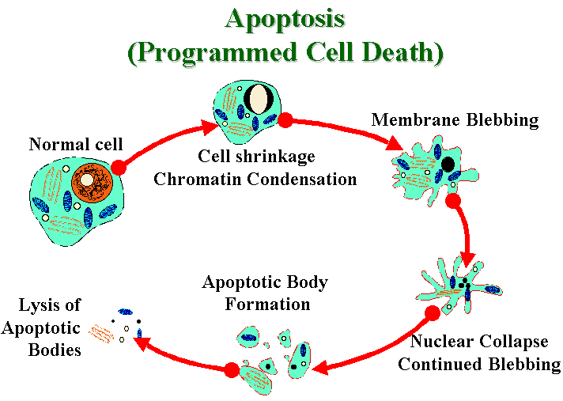

Slide 3
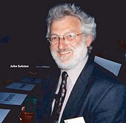
The 2002 Nobel Prize in Medicine was awarded to Sydney Brenner, Horvitz and John E. Sulston for their work
identifying genes that control apoptosis. The genes were identified by studies in the nematode C. elegans and these same genes function in humans for apoptosis.

Slide 4
Apoptosis has since been recognized and accepted as a distinctive and important mode of “programmed” cell death, which involves the genetically determined elimination of cells.
Apoptosis is essential to embryonic development and the maintenance of homeostasis in multicellular organisms. In humans, for example, the rate of cell growth and cell death is balanced to maintain the weight of the body. During fetal development, cell death helps sculpt body shape and making the right neuronal connections.

Slide 5
Tissue homeostasis mainly depends on the balance between cell proliferation and cell death. Programmed cell death or apoptosis is an intrinsic death program that occurs in various physiological and pathological situations .
Apoptosis or self destruction is necessary for normal development and homeostasis of multicellular organisms.
Apoptosis plays a major role in many diseases like cancer,
AIDS and
neurodegenerative disorders.

Slide 6
Cell death
Cell die by one of two mechanisms-
- Necrosis - Death By Injury
- Apoptosis - Death By Suicide
Apoptosis and necrosis have different characteristics

Slide 7
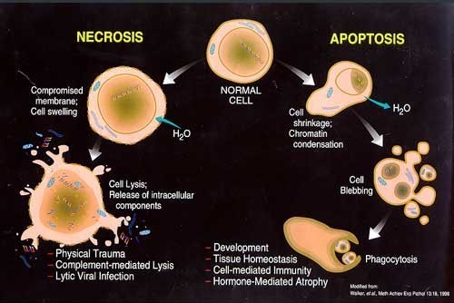
NECROSIS Vs APOPTOSIS

Slide 8
APOPTOSIS ( Physiological cell death)
NECROSIS ( Pathological cell death)
Functional form of cell death
Accidental form of cell death
Occurs under physiological conditions
Seen under pathological conditions
Energy (ATP)- dependent
No energy requirement
Cell shrinks and pulls away from its Cell swelling in a defining features neighbours
Nucleus ruptures
Entire cell balloons and ruptures
Induced by physiological stimuli( lack of
Induced by non-physiological disturbances
growth factor, changes in harmonal
lytic viruses, hypothermia,hypoxia,
environment
ischaemia,metabolic poisons
No inflammation follows apoptosis
Necrosis is followed by inflammation

Slide 9
Need Of Apoptosis
Apoptosis is needed for proper development
Examples:
The resorption of the tadpole tail
The formation of the fingers and toes of the fetus
The formation of the proper connections between neurons in the brain
Apoptosis is needed to destroy cells
Examples:
Cells infected with viruses Cells with DNA damage Cancer cells

Slide 10

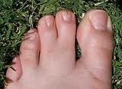
Incomplete differentiation due to lack of Apoptosis

Slide 11
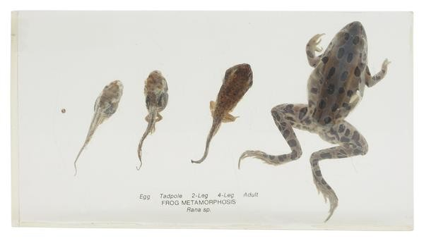

Slide 12
Reasons of apoptosis
Withdrawal of positive signals
examples :
  growth factors for neurons
  Interleukin-2 (IL-2)
Receipt of negative signals
examples :
  increased levels of oxidants within the cell
  damage to DNA by oxidants
  death activators :
    Tumor necrosis factor alpha (TNF-α)
    Lymphotoxin (TNF-β)
    Fas ligand (FasL)

Slide 13
Inducers of Apoptosis
•
TNF family
•
•
Growth factor withdrawl
Calcium
•
Oncogenes
•
Nutrient deprivation
•
Toxins
•
UV radiation
•
Gamma radiation

Slide 14
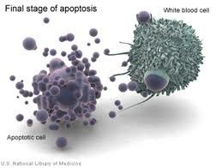
Apoptosis in physiological conditions
In human body about 100,000 cells are produced every second by mitosis and a similar no. die by apoptosis

Slide 15
Important in normal physiology
  Development: Immune systems maturation, Morphogenesis, Neural development
  Adult: Immune privilege, DNA Damage and wound repair.
Excess apoptosis
  Neurodegenerative diseases
Deficient apoptosis
  Cancer
  Autoimmunity

Slide 16
Caspases
•
Caspases stands for cysteine aspartate-specific protease.
•
Caspases have the characteristics of high specificity for
substrates containing Asp, and use a Cys for catalyzing peptide
bond cleavage.
•
Synthesized in the cell as precursors named procaspase.
•
Caspases are the major executioners in apoptosis.

Slide 17
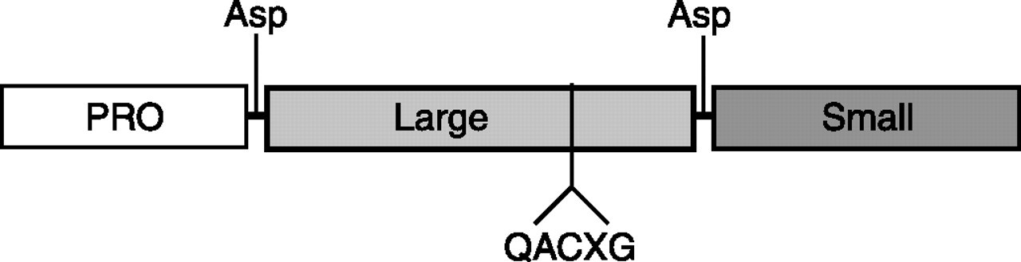
Caspase Structure
•
NH₂-terminal domain
Large subunit (~20kD)
Small subunit (~10kD)
•
•

Slide 18
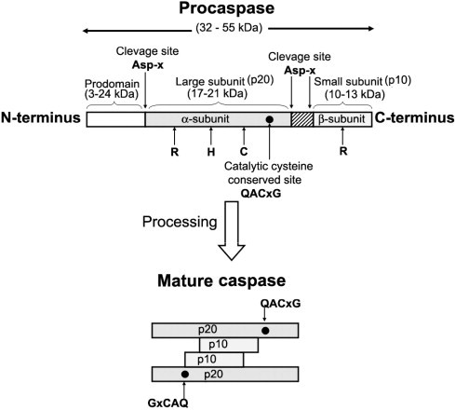
Caspase Activation

Slide 19
Caspase Role in Apoptosis
Cut off contact with surrounding cells
Reorganize cytoskeleton
Shut don DNA replication and repair
Interrupt splicing
Destroy DNA
Disrupt nuclear structure
Induce cell to display signals marking it for phagocytosis
Disintegrate cells into apoptotic bodies

Slide 20
Types
Two types:
- those involved in apoptosis:
Initiators – activate downstream effector caspases to initate activation cascades:
Caspases2 Caspases9 Caspases8 Caspases10
Effectors - cleave target proteins resulting in morphological and biochemical markers of apoptosis:
Caspases3 Caspases6 Caspases7 Caspases14

Slide 21
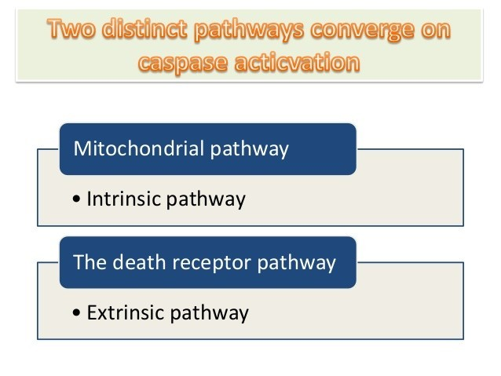

Slide 22
Apoptosis: Pathways
“Extrinsic Pathway”
Death
Ligands
Death
Receptors
Initiator Caspase 8
Effector Caspase 3
PCD
“Intrinsic Pathway”
DNA
damage & p53
Initiator Caspase 9
Mitochondria/
Cytochrome C

Slide 23
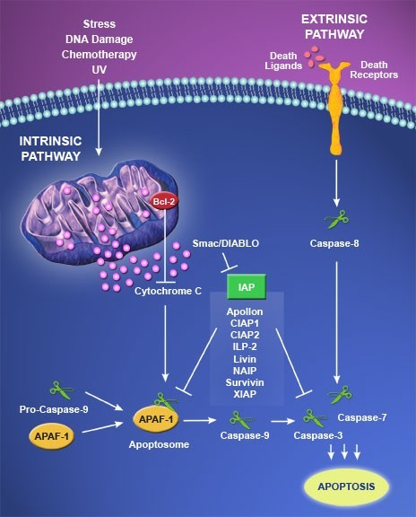

Slide 24
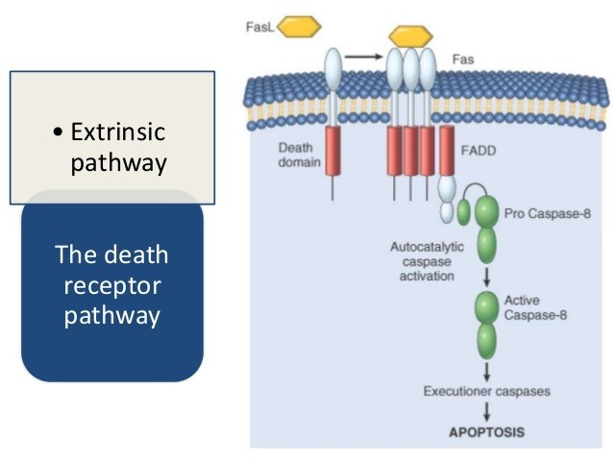

Slide 25
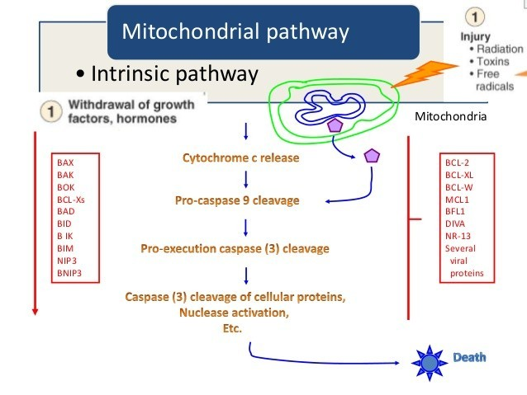

Slide 26
Intrinsic Pathway
Initiated from within the cell.
Activated in response to signals such as DNA damage, loss of cell survival factors ,cell stress.
Hinges on balance brtween pro and antiapoptotic signals of Bcl-2 family.
Apaf-1,cytochrome-c,ATP(apoptosome) activate procaspase-9 complex.
pro apoptotic proteins released which activate caspase proteases

Slide 27
Extrinsic Pathway
Begins outside the cells.
Activation of death receptors (Fas-R,TNF-R ,DR- 3,DRY/DR5) by death ligands (Fas-L,TNF- alpha,Apo3L,Apo2L)play major role.
Death induced signalling compex (DISC) activated.
On DISC activation same effctor pathway as intrinsic pathway is adopted

Slide 28
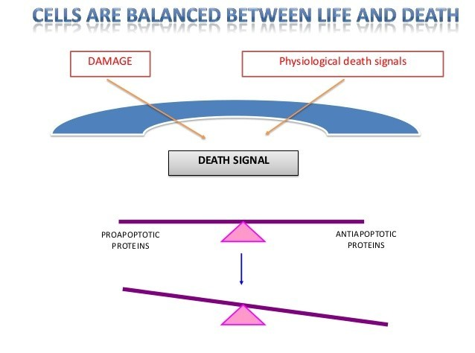

Slide 29
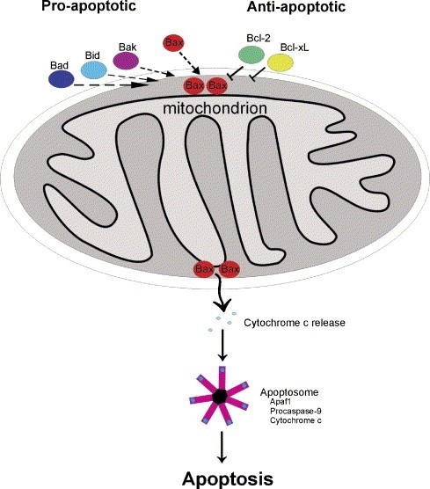

Slide 30
Disorders where apoptosis is inhibited (decreased apoptosis,increase in cell survival)

Slide 31
Cancer Colorectal cancer Glioma
Liver
Lymphoid malignancies Neuroblastoma
Prostate cancer Follicular lymphomas
Carcinomas with p-53 mutations
Autoimmune disorders
Mysthenia gravis
Systemic lupus erythematous

Slide 32
Inflammatory disease
Bronchial asthma Inflammattory bowel disease Pumonary inflammation
Viral infections
Herpesviruses Poxviruses Adenoviruses Baculovirus Cowpox

Slide 33
Disorders where apoptosis is excessive
increase in cell death (Means hyperactive apoptosis).

Slide 34
1 AIDS
CD4+ cells
T- lymphocytes
2. Neurodegenerative disorders
Alzheimer’s disease Epilepsy Parkinson’s disease
Amyotrophic lateral sclerosis
Retinitis pigmentosa Cerebellar degeneration

Slide 35
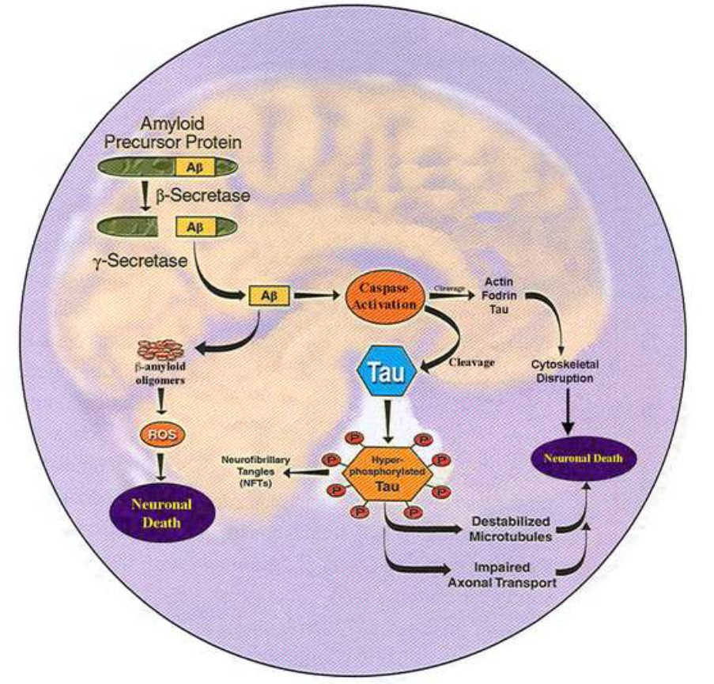
Role of Caspases in Alzheimer's Disease

Slide 36
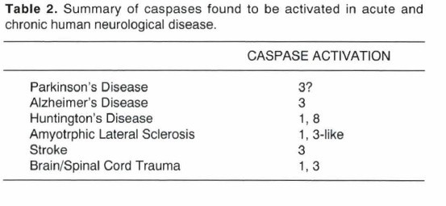

Slide 37
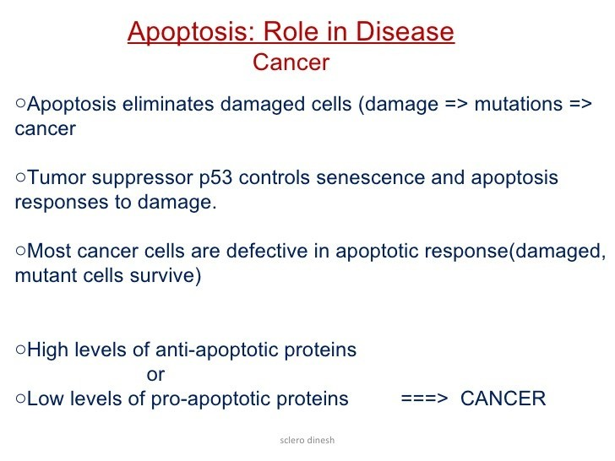

Slide 38
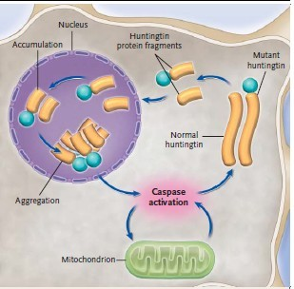
Role of Caspases in HUNTINGTON DISEASE
3

Slide 39
AIDS
Autoimmune deficiency syndrome (AIDS) is an example of an autoimmune disease that results from infection with the human immunodeficiency virus (HIV) . This virus infects CD4+ T cells by binding to the CD4 receptor. The virus is subsequently internalized into the T cell where the HIV Tat protein is thought to increase the expression of the Fas receptor, resulting in excessive apoptosis of T cells .

Slide 40
So what kills so many uninfected CD4+ cells? Answer is: Apoptosis.
There are several possibilities. One of them:
All T cells, both infected and uninfected, express Fas.
Expression of a HIV gene (called Nef) in a HIV- infected cell causes
  The cell to express high levels of FasL at its surface
  While preventing an interaction with its own Fas from causing it to self-destruct.
However, when the infected T cell encounters an uninfected one (e.g. in a lymph node), the interaction of FasL with Fas on the uninfected cell kills it by apoptosis.

Slide 41
Recent advances
•
Caspase inhibitors such as N-benzyloxycarbonyl-Val-Ala- Asp fluoromethyl-ketone (Z-VAD) were being investigated for the treatment of a number of neurodegenerative disorders including:-
Alzheimer disease
amyotrophic lateral sclerosis (ALS)
Huntington’s disease
Parkinson’s disease (PD)
and finally acute neurologic diseases including ischemia or traumatic injury .
Unfortunately, clinical development of Z-VAD was discontinued following the recognition that metabolism of Z- VAD produces liver damage following the production of the toxic compound, fluoroacetate .

Slide 42
Following the disappointment of Z-VAD, a number of other caspase inhibitors have been developed with the goal in mind of being safer and more selective-
Quinolyl-valyl-Omethylaspartyl-[- 2, 6- difluorophenoxy]-methyl ketone (QVD-OPh)-
-Q-VD-OPh appears to be able to cross the blood- brain barrier, which is always a central issue when developing a drug for treatment of a CNS disorder.
-including greater potency, selectivity,stability and cell permeability
-After acute treatment of mice with Q-VD-OPh, all organs were normal suggesting a lack of toxicity.

Slide 43
Another promising compound that is currently under evaluation is Minocycline, a second- generation tetracycline. In comparison to Q-VD- OPh, minocycline is much further along as an investigational drug for the treatment of neurodegenerative disorders and in some cases human clinical trials have begun. For example,
  Phase II for PD
  Phase I/II for spinal cord injury
  Phase III trail for ALS

Slide 44
Caspase-6:A Potential Therapeutic Target for Neurodegenerative Disease:
Many studies, as recently reviewed byGraham et. al. in Trends in Neurosciences, have revealed Caspase-6 as a possible contributor to neurodegenerative pathology associated with Huntington’s Disease (HD), Alzheimer’s Disease (AD), aging, and stroke.
zVADfmk ,zVEIDfmk & zDHRDfmk (under research) are peptide agents to inhibit CASP-6.
5. Inflammatory caspase inhibitors, such as VX-740 (Pralnacasan) and VX-765(caspase-1 inhibitor VX-765 is undergoing phase 2 clinical trials by Vertex) in clinical studies for rheumatoid arthritis and osteoarthritis.

Slide 45
The present findings indicate that nonlipid LPA₂- specific agonists represent an excellent starting point for development of lead compounds with potential therapeutic utility for preventing the programmed cell death involved in many types of degenerative and inflammatory diseases.
Lysophosphatidic acid (LPA) is a highly potent endogenous lipid mediator that protects and rescues cells from programmed cell death. Earlier work identified the LPA₂ G protein-coupled receptor subtype as an important molecular target of LPA mediating anti apoptotic signaling

Slide 46
GRI977143, which was effective in reducing activation of caspases 3, 7, 8, and 9 .
On the basis of the present results, it is concluded that vitamin D displays anti-apoptotic effects in human osteoblast-like osteosarcoma cells in vitro. This observation suggests that besides regulating growth and differentiation, vitamin D exerts its anabolic effects on bone by protecting osteoblastic cells from undergoing apoptosis.

