Slide 1
LETHAL DOSE 50 (LD50)
The amount of a toxic agent (as a poison, virus, or radiation) that is sufficient to kill 50 percent of a
population of animals usually within a certain time
Also called median lethal dose
Expressed as milligrams of substance per kilogram of body mass
Compare the toxic potency or intensity of different chemicals
A measure of acute toxicity

Slide 2



LETHAL DOSE 50 (LD50)
A
10 mg causes kidney toxicity
B
10 mg causes neuro toxicity
Which drug is more toxic?
LD50

Slide 3
SIGNS RECORDED DURING ACUTE TOXICITY STUDIES
These are increased motor activity, anaesthesia, tremors, arching and rolling, clonic convulsions, tonic extension,
lacrimation, Straub reaction, salivation, muscle spasm, writhing, hyperesthesia, loss of righting reflex, depression, ataxia,
stimulation, sedation, blanching, hypnosis, cyanosis and analgesia

Slide 4
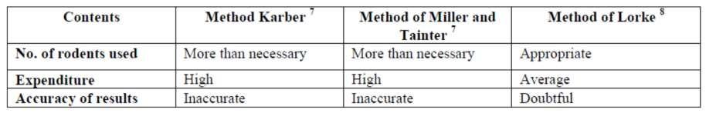
DIFFERENT METHODS FOR THE DETERMINATION OF LD50
Graphical method, arithmetical method and statistical approach
  For research purpose, the most widely used method is Litchfield
and Wilcoxson
  For routine practical class work; Reed-Muench, Miller-Tainter and
Karber’s Method
Arithmetical method: Karber method
Graphical method: Miller and Tainter

Slide 5
DIFFERENT METHODS FOR THE DETERMINATION OF LD50
For calculating LD50 by any one method:
  Find out the least tolerated (smallest) dose (100% mortality) and most tolerated (highest) dose (0% mortality) by hit and trial method
  Once these two doses are determined, select at least 5 doses in
between them, and observe mortality due to these doses
  Apply correction factor to 0% and 100% mortality group [for 0%
dead = 100 (0.25/n) and for 100% dead = 100x (n-0.25/n), where n
= number of death]
  The percentage mortality values are converted to probit values
by reading the corresponding probit units from the probit table
  Plot the probit value against log doses and read LD50 value as
the dose that corresponds to probit

Slide 6
Probit Values
Bliss proposed transforming the percentage- killed into a "probability unit" (or " probit")
Defined as arbitrarily as equal to 0 for 0.0001 and 10 for 0.9999)
Probit table aids other researchers to convert their kill percentages to his probit, which they could then plot against the logarithm of the dose and thereby, it was hoped, obtain a more or less straight line
Such a so-called probit model is still important in toxicology, as well as other fields

Slide 7
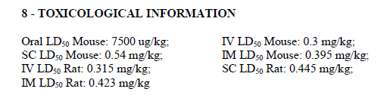
GRAPHICAL METHOD OF MILLER- TAINTER
The Miller-Tainter method is the standard use in getting
LD50
The dose is plotted against the probit value. Based on the
graph, the LD50 will be estimated
The experiment demonstrates the determination of LD50
of neostigmine on the experimental animals and its
comparison to the standard LD50 of neostigmine
  Neostigmine (0.1 mg/kg, 0.2 mg/kg, 0.4mg/kg, 0.8 mg/kg,1.6 mg/kg, 3.2 mg/kg) i.p
  0.5 mg/ml

Slide 8
OBJECTIVES
General Objective:
  To determine the Median Lethal Dose of neostigmine
introduced on mice intraperitoneally
Specific Objectives:
  To determine the number of deaths per dose of neostigmine one hour after intraperitoneal administration
  To determine the LD50 of neostigmine using the Miller-Tainter method
  To compare the experimentally determined LD50 to the theoretical standard of LD50

Slide 9
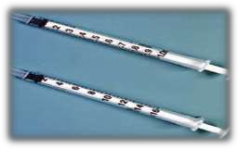

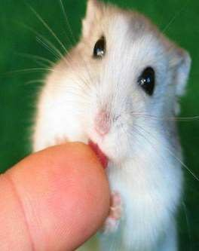
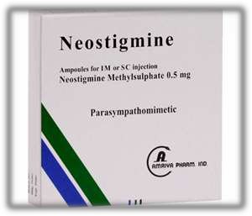
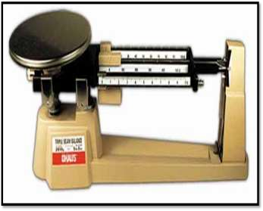
MATERIALS AND METHODS
60 male mice, approximately same weight
Neostigmine 0.5 mg/ml injections

Slide 10
60 MICE
MATERIALS AND METHODS
10 10 10 10 10 10
DIFFERENT DOSAGES (IN GEOMETRIC INCREMENT) PER Kg
0.1mg 0.2mg 0.4mg 0.8mg 1.6mg 3.2mg

Slide 11
MATERIALS AND METHODS
The number of dead mice, within an hour was
counted (% dead)
Abnormal behaviors, tremors and seizures were observed and noted
The rationale for using the geometric dosage
sequencing is that this is more cost-efficient and
allows experimenters to see the effect without sacrificing too many animals

Slide 12
RESULTS
Apply correction factor to 0% and 100% mortality group [for 0% dead = 2.5% and for 100% dead = 97.5%]
% Response conversion to Probit Units by the Probit Transformation Table
Convert Doses to log Dose (log10 dose = x)
The probit value and the percentage of deaths against log dose are plotted

Slide 13
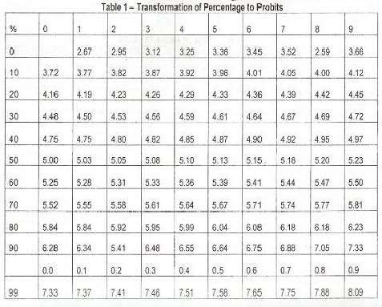

Slide 14

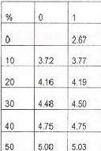
RESULTS
Sample Probit Computation
For the
20% response
20% = 4.16

Slide 15


RESULTS
Sample Probit Computation
For the 2.5% response
2.5% = 2.95 + 3.12 = 3.035
2

Slide 16
PLOT
% RESPONSE
PROBIT UNITS
LOG DOSE

Slide 17
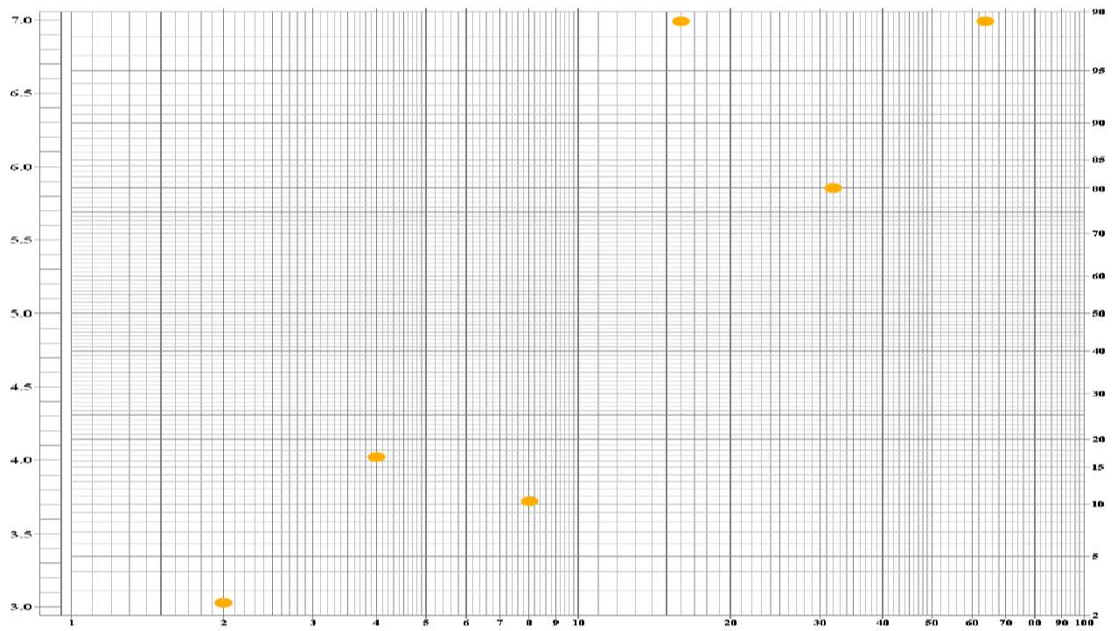



Slide 20
LINEAR REGRESSION

Slide 21
RESULTS
From the regression of the probit-log dose line, the log dose was extrapolated corresponding to probit units of 5
The extrapolated dose corresponds to the median lethal log dose, and the antilog of this log dose value would be the LD50 value
The dose corresponding to 50% or probit 5 was taken as LD50

Slide 22
LIMITATIONS OF LD50
The LD50 gives a measure of the immediate or acute toxicity
Results may vary greatly
LD50 is not tested on humans
All relation to humans are only a guess
The LD50 test is neither reliable nor useful Because the human lethal dose is difficult to be predicted from animal studies

