Slide 1
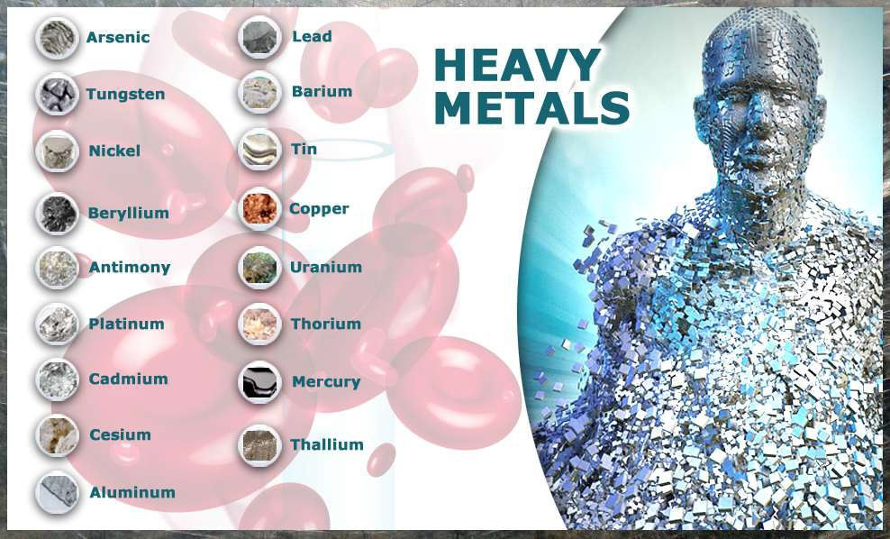
There are total 23 Heavy Metals

Slide 2
The Symptoms
Mental disorders
Pain in muscle and joints
Gastro intestinal
disorders
Vision problems
Chronic fatigue
Susceptibility to fungal
infections

Slide 3
SOURCES OF POLLUTION FROM
HAZARDOUS METALS
Natural Sources
Anthropogenic Sources

Slide 4
Natural Sources
Seepage form rock | Volcanic Activity | Forest Fire

Slide 5
These toxic elements enter the human body mostly through Food and Water

Slide 6
1. Arsenic

Slide 7
SOME FACTS ABOUT ARSENIC
Arsenic is the most common cause of acute heavy metal poisoning in adults
and is number 1 on the ATSDR's "Top 20 List.“
Arsenic is released into the environment by the smelting process of copper, zinc, and lead, as well as by the manufacturing of chemicals and glasses.
People can be exposed to arsenic by inhaling it, by consuming contaminated foods, water, or beverages, or by skin contact.
. People may be exposed to higher levels if they live near industrial areas.

Slide 8
SYMPTOMPS
Vomiting
Abdominal Pain
Diarrhea
Dark urine (termed black water urine)
Dehydration
Cardiac problems
Hemolysis (destruction of red blood cells)
Vertigo
Delirium
Shock
Death

Slide 9
Arsenic has been classified as a Carcinogen by the Environmental Protection Agency (EPA).

Slide 10
The permissible exposure limit for arsenic is no greater than 10 micrograms of inorganic arsenic per cubic meter of air, averaged over any 8 hour period for a 40 hour workweek

Slide 11
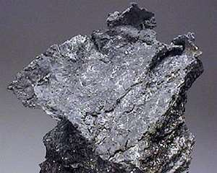
2. Lead

Slide 12
SOME FACTS ABOUT LEAD
Lead is number 2 on the ATSDR's "Top 20 List." Lead accounts for most of the cases of pediatric heavy metal poisoning (Roberts 1999).
It is a very soft metal and was used in pipes, drains, and soldering
materials for many years.
Lead poisoning occurs when lead builds up in the body, often over a period of months or years

Slide 13
SOURCES
Lead-based paint and lead-contaminated dust in older buildings.
Contaminated air, water and soil.
Adults who work with batteries
Do home renovations
Work in auto repair shops.

Slide 14
SYMPTOMPS
High blood pressure
Abdominal pain
Constipation
Joint pains
Muscle pain
Declines in mental functioning
Pain, numbness or tingling of the extremities
Headache, Memory loss, Mood disorders
Reduced sperm count, abnormal sperm
Miscarriage or premature birth in pregnant women

Slide 15

. The US Centers for Disease Control and Prevention and the World Health Organization state that a blood lead level of 10 μ g/dL or above is a cause for concern

Slide 16
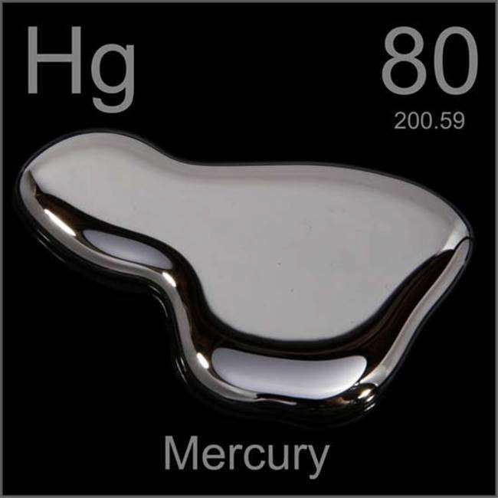
3. Mercury

Slide 17
FACTS ABOUT MERCURY
"Top 20 List" is mercury.
Mercury is generated naturally in the environment from the degassing of the earth's crust, from volcanic emissions.
It exists in three forms: elemental mercury and organic and
inorganic mercury.
Exposure to the various forms of mercury can result in some similar and some different symptoms.

Slide 18
SOURCES
Mining operations
Chloralkali plants
Paper Industries

Slide 19
Symptoms can be grouped into three categories based on the form of mercury toxicity:
1)Elemental and vaporized mercury 2)Organic mercury
3)Inorganic mercury

Slide 20
SYMPTOMPS
Damage to the brain, kidneys and lungs.
Mercury poisoning can result in several diseases, including Acrodynia (pink disease), Hunter-Russell syndrome, and Minamata disease.

Slide 21
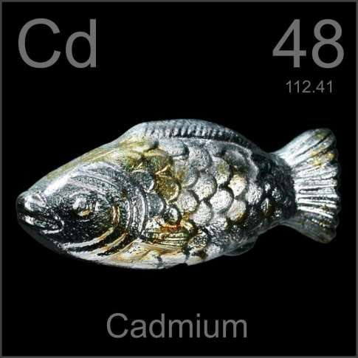
4. Cadmium

Slide 22
SOURCES
Cadmium is regularly found in ores together with zinc, copper
and lead. Therefore volcanic activity is one natural source.
Cadmium is widely used in industrial processes, e.g.: as an anticorrosive agent
As a stabilizer in PVC products
As a color pigment
A neutron-absorber in nuclear power plants
In the fabrication of nickel-cadmium batteries

Slide 23
Acute exposure to cadmium fumes may cause flu-like symptoms including chills, fever, and muscle ache sometimes referred to as "the cadmium blues."

Slide 24
SYMPTOMPS
More severe exposures can cause
Tracheo-bronchitis, pneumonitis, and pulmonary edema.
Symptoms of inflammation may start hours after the exposure and include cough, dryness and irritation of the nose and throat, headache, dizziness, weakness, fever, chills, and chest pain.
The bones become soft (osteomalacia), lose bone mineral density (osteoporosis) and become weaker.
The kidneys lose their function to remove acids from the blood
in proximal renal tubular dysfunction

Slide 25
The National Institute for Occupational Safety and Health (NIOSH) recommended that exposures to any form of cadmium at concentrations greater than 40
µg/m3 (determined as a TWA for up to a 10-hour workday, 40-hour workweek) or at a ceiling concentration greater than 200 µg/m3 for any 15-
minute period not be permitted.

Slide 26
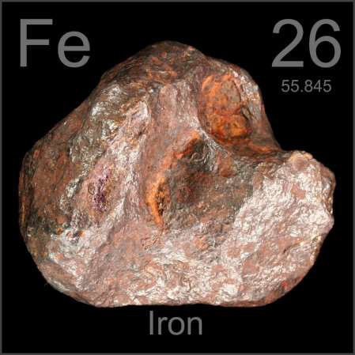
5. Iron

Slide 27
SOME FACTS ABOUT IRON
Iron is a mineral found in many over-the-counter supplements.
Iron overdose occurs when someone accidentally or intentionally takes more than the normal or recommended amount of this medication.
Iron overdose is especially dangerous to children. Children
younger than 6 years may eat too many multivitamins.
Other sources of iron are drinking water, iron pipes, and cookware.

Slide 28
SYMPTOMPS
Stomach Pain
Nausea and vomiting
Bloody vomiting
Metabolic acidosis, which in turn damages internal organs,
particularly the brain and the liver.
Iron poisoning can cause hypovolemic shock due to iron's potent ability to dilate the blood vessels
Death may occur from liver failure.

Slide 29
The amount of iron ingested may give a clue to potential toxicity. The therapeutic dose for iron deficiency anemia is 3–6 mg/kg/day. Toxic effects begin to occur at doses above 10–20 mg/kg of elemental iron. Ingestions of more than 50 mg/kg of elemental iron are associated with severe toxicity

Slide 30
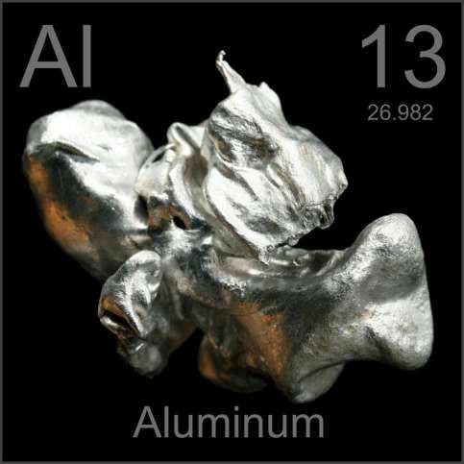
6. Aluminum

Slide 31
SOME FACTS ABOUT IRON
1. Although aluminum is not a heavy metal (specific gravity of 2.55-
2.80), it makes up about 8% of the surface of the earth
It is the third most abundant element.
Aluminum toxicity occurs when a person ingests or breathes high
levels of aluminum into the body

Slide 32
SOURCES
Food additives
Antacids
Buffered aspirin
•
Astringents, nasal sprays, and antiperspirants
Drinking water
Automobile exhaust and tobacco smoke
Aluminum foil, aluminum cookware, cans, ceramics
Fireworks

Slide 33
SYMPTOMPS
Confusion
Muscle weakness
Bone pain, deformities, and fractures
Seizures, Speech problems, slow growth—in children
Lung problems
Nervous system problems causing difficulty with voluntary and involuntary actions
Bone diseases
Brain diseases and disorders
Anemia
Impaired iron absorption

Slide 34
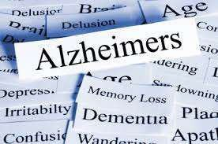
Aluminum might have a possible connection with developing Alzheimer's disease However this has not been proved. Therefore, at this time, reducing exposure to aluminum is a personal decision.

Slide 35
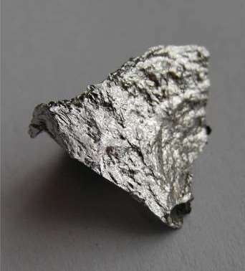
7. Manganese

Slide 36
SOURCES
Inhalation of dust
Absorption through the skin
Ingestion.

Slide 37
SYMPTOMPS
Anorexia
Asthenia
Apathy
Somnolence
Headaches, etc.
A few may experience a brief period of aggressiveness, increased sexual activity, and hallucinations.
The toxicity may be manifested as a chronic disorder of the
central nervous system (CNS) resembling Parkinson's disease

Slide 38
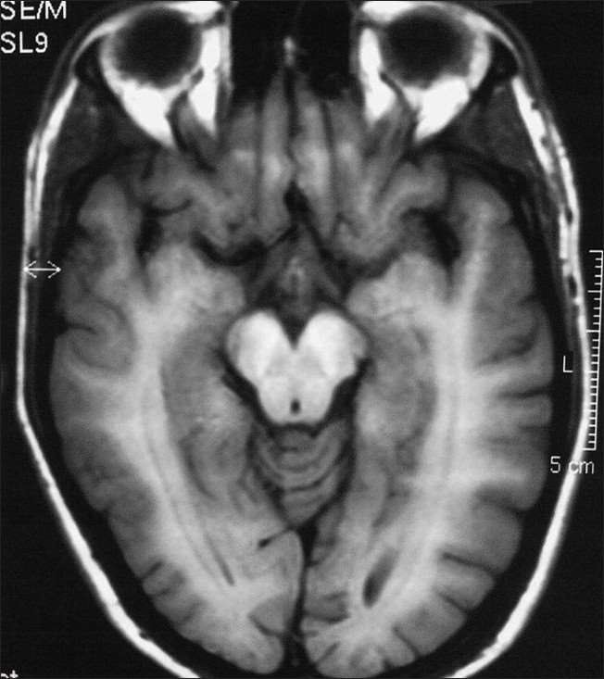
Concentration > 10 µg/L blood is suggestive of
manganese exposure.

Slide 39
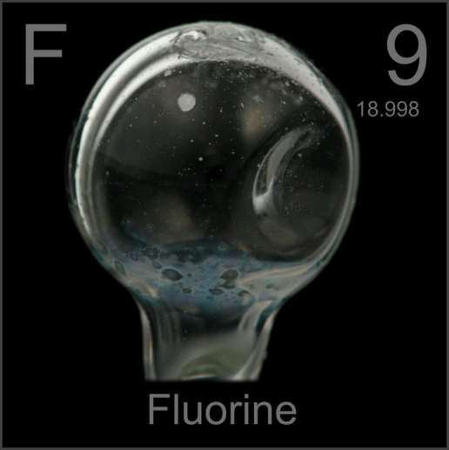
8. Fluoride

Slide 40
SOME FACTS ABOUT FLUORIDE
Fluoride is poorly absorbed from intact skin but readily absorbed from the lung and the gastrointestinal tract
It accumulates in the body at levels of 4 mg/day.

Slide 41
Skeletal fluorosis, resulting in an increased bone density associated with skeletal deformities and spinal rigidity.
Skeletal changes as well as musculoskeletal complaints are observed in highly exposed groups

