Slide 1
SMOG and Air Quality Index
Dr Muhammad Khalil ahmad khan

Slide 2
Air Quality Index
The AQI takes into consideration 6 major pollutants:
Sulfur Dioxide (SO2),
Carbon Monoxide (CO),
Nitrogen Dioxide (NO2)
Ozone (O3)
Atmospheric Particulate Matter
Lead (Pb)
EPA can assign a number regarding its AQI Range.
The AQI is divided in 6 categories:
0 – 50 (Good),
51 – 100 (Moderate),
101 -150 (Unhealthy for sensitive groups),
151 – 200 (Unhealthy),
201 – 250 (Very Unhealthy) and
251 – 300 (Hazardous).

Slide 3
Set of Air Pollutants that cause Smog, Acid Rain and other health effects
Six criteria air pollutants were the first set of pollutants recognized by US EPA as needing standards on National Level.
Ozone (O3)
Atmospheric Particulate Matter
  PM10; Coarse particles (2.5-10uM in size )
  PM2.5; Fine Particles (2.5uM in size or less)
Lead (Pb)
Carbon monoxide (CO)
Sulfur Oxides (SOx); esp. SO2
Nitrogen Oxides (NOx); Nitric Oxide (NO), Nitrous Oxide (N2O), Nitrogen Dioxide (NO2)

Slide 4
Primary Pollutants
Sulfur Oxides (SOx)
  SO2 - sulfur dioxide
  produced largely through coal burning
  responsible for acid rain problem
Volatile Organic Compounds (VOCs)
  highly reactive organic compounds (carbon compounds; plants (Isoprene, Terpenes)
  released through incomplete combustion and industrial sources (Paints and coatings), (Solvents; ethyl acetate, Acetone etc)
Particulate Matter (dust, ash, smoke, salt)
  10 um particles (PM10) stay lodged in your lungs
  2.5 um particles (PM2.5) can enter blood stream

Slide 5
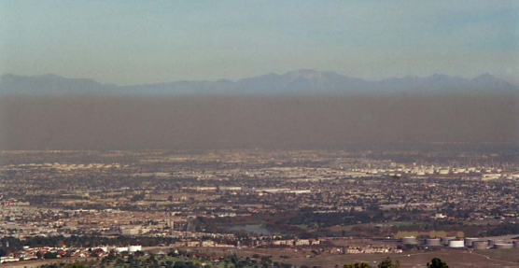
Secondary Pollutants
Form in atmosphere from chemical-photochemical reactions that involve primary pollutants
Sulfuric Acid H2SO4
  major cause of acid rain
Nitrogen Dioxide NO2
  brownish hue
L.A. Sky Colors Dec 2000
Mark Z. Jacobson

Slide 6
Secondary Pollutants
Ozone O3
  colorless gas
  has an pungent, sweet smell
  oxidizing agent
Primary and secondary pollutants are found in the two types of smog:
  London-type smog
  LA-type photochemical smog
SMOG = SMOKE + FOG

Slide 7
Types of SMOG
Sulfurous smog and photochemical smog
Sulfurous smog, also known as London smog, develops due to high concentration of sulfur oxides in the air.
It is released into the air by sulfur-bearing fossil fuels like coal.
Volcanoes also emit sulfur dioxide in the atmosphere.

Slide 8
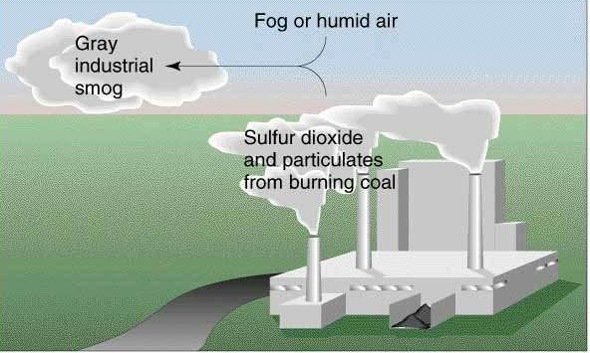
Formation of industrial smog( London smog)

Slide 9
Some SO₂ Chemistry in the atmosphere
X
In the gas phase (clear sky, no clouds):
•
SO₂ + •OH → HSO₃
HSO₃ + O₂ → HOO• + SO₃
SO₃ + H₂O → H₂SO₄
•
In mist:
H₂SO_{4(g)} + H₂O → H₂SO_{4(aq)}
SO_{2(g)} + H₂O_{(l)} → H₂SO_{3(aq)}

Slide 10
Photochemical smog
Photochemical smog is a mixture of pollutants that are formed when nitrogen oxides and volatile organic compounds (VOCs) react to sunlight, creating a brown haze above cities.
It tends to occur more often in summer, because that is when we have the most sunlight.

Slide 11
Oxide (NO) acts to remove ozone (O3) from the atmosphere and this mechanism occurs naturally in an unpolluted atmosphere.
O 3 + NO »»» NO 2 +O 2
NO + RO 2 »»» NO 2
Sunlight can break down nitrogen dioxide (NO2) back into nitrogen oxide (NO).
NO 2 + sunlight »»» NO +O
The atomic oxygen (O) formed in the above reaction then reacts with one of the abundant oxygen molecules (which makes up 20.94 % of the atmosphere) producing ozone (O3).
O + O 2 »»»O 3
However, it is consumed by nitrogen oxide as illustrated in the first reaction.
The introduction of volatile organic compounds results in an alternative pathway for the nitrogen oxide, still forming nitrogen dioxide but not consuming the ozone, and therefore ozone concentrations can be elevated to toxic levels.

Slide 12
Photolytic Cycle
ENGINE
NO₂
UV Radiation from sunlight
NO + O
O₂
O₃
O₂
Continued

Slide 13
Photolytic Cycle
ENGINE
NO₂
UV Radiation from sunlight
Volatile Organic Compounds
Alternative Pathway for formation of NO2 but not consuming the O3
NO + O
O₂
O₃
O₂
Continued

Slide 14
Human Response to One Hour Pollutant Exposure
Pollutant | Concentration Part per million by mass | Symptom
CO | 10-30 ppmm | Time distortion (typical urban level)
 | 100 ppmm | Throbbing headache (freeway background, 100 ppmm)
 | 300 ppmm | Vomiting, collapse (tobacco smoke, 400 ppmm)
 | 600 ppmm | Death
CO sticks to hemoglobin, forming carboxyhemoglobin (COHb), which reduces the capacity of hemoglobin to carry O2 to cells

Slide 15
Human Response to One Hour Pollutant Exposure
Pollutant | Concentration Parts per million by mass | Symptom
NO2 | 0.06-0.1 ppmm | Respiratory impact (long term exposure promotes disease)
 | 1.5-5.0 ppmm | Breathing difficulty
 | 25-100 ppmm | Acute asthma
 | 150 ppmm | Death (may be delayed)

Slide 16
Human Response to One Hour Pollutant Exposure
Pollutant | Concentration Parts per million by mass | Symptom
O3 | 0.02 ppmm | Odor threshold (sweet)
 | 0.1 ppmm | Nose and throat irritation in sensitive people
 | 0.3 ppmm | General nose and throat irritation
 | 1.0 ppmm | Airway resistance, headaches (long term lead to premature aging of lung tissue)

Slide 17
Human Response to One Hour Pollutant Exposure
Pollutant | Concentration Parts per million by mass | Symptom
SO2 | 0.3 ppmm | Taste threshold (acidic)
 | 0.5 ppmm | Odor threshold (acrid)
 | 1.5 ppmm | Bronchiolar constriction Respiratory infection

Slide 18
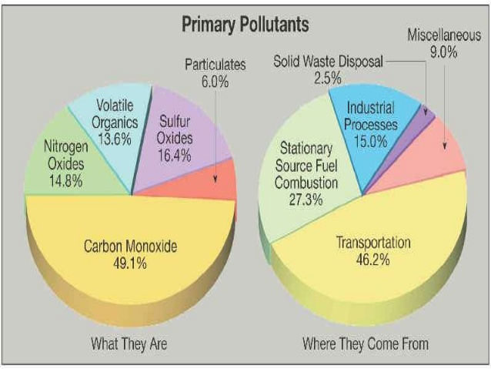

Slide 19
Major Air Pollution Episodes of Historic Significance
1960s - NYC had several severe smog episodes
1950s onward – LA had many smog alerts from an increase in industry and motor vehicle use
Led to passage of the Clean Air Act of 1970 (updated 1977 and 1990)
  Empowered Federal Government to set emission standards that each state had to meet

Slide 20
Major Air Pollution Episodes of Historic Significance
Some of the worst events in the last two centuries occurred in London
  Key ingredients: calm winds, fog, smoke particles from coal burning
  1873 - 700 deaths
  1911- 1150 deaths
  1952 - 4000 deaths
Last event led to the Parliament passing a Clean Air Act in 1956

Slide 21
The London Smog Disaster of 1952.
Days of toxic darkness.
Early on 5th of December 1952 the London sky was clear, the weather was considerably colder than usual, as it had been for some weeks.
As a result the people of London were burning large amounts of coal and smoke bellowed from the chimneys.
The winds were light and the air near the ground was moist, conditions ideal for formation of radiation fog

Slide 23
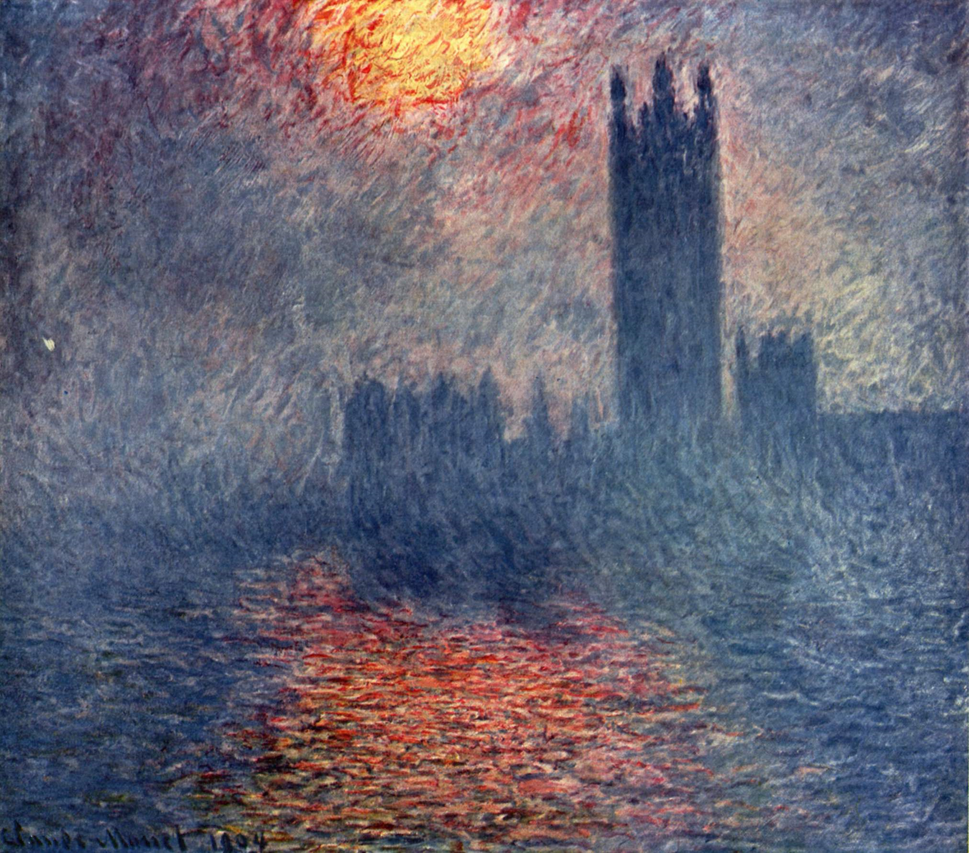
How Claude Monet saw London in 1899

Slide 24
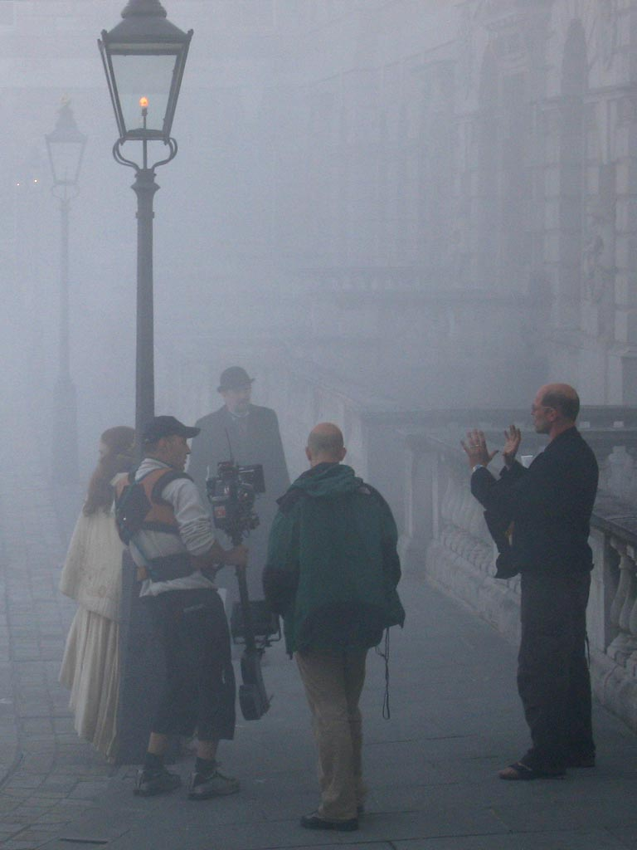

Slide 25
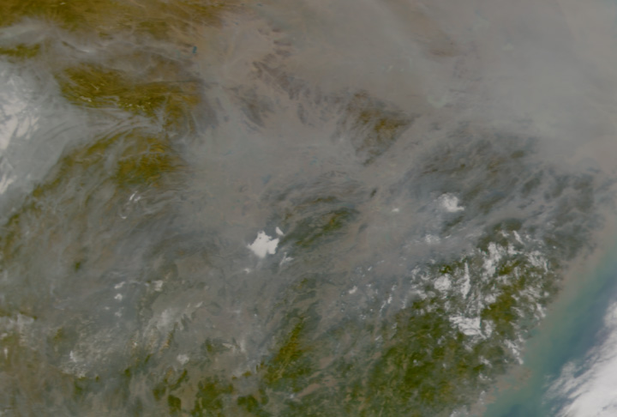
SMOG and Haze over China
January 10, 2003
http://www.nasa.gov/centers/goddard/news/topstory/2003/0110chinahaze.html

Slide 26
Health Effects.
The deaths which resulted from the smog can be attributed primarily to;
    Pneumonia
    Bronchitis
    Tuberculosis
    Heart failure
People with bronchitis and other respiratory conditions such as asthma wheezed to their deaths in their beds.
Most deaths were a result of respiratory and cardiac distress. Since that time the adverse health effects of smog have been identified, including:
An increased number of deaths
Increased hospital admissions and sick days

Slide 27
Health Effects.
Respiratory effects
    Short term decrease in breathing ability and increase in chest pains
    Inflammation of the lungs and damage to respiratory cells
    Permanent lung damage and reduced quality of life due to ozone.
    Increased number of asthma attacks due to nitrogen dioxide.
Cardiovascular effects
    A lack of oxygen in the bloodstream in those with heart disease due to carbon monoxide.
    Increased risk of cancer
    Increased susceptibility to infection among children

Slide 28
Pollutants such as smoke and sulphur dioxide were partly to blame.
In the following graph you can see that smoke and sulphur dioxide peaks coincide with peaks in the peaks in deaths

Slide 29
The Great London Smog shocked the government to clean up the nation’s air and as a consequence the first clean air acts were introduced.
1956 Clean Air Act.
This Act was directed at domestic sources of smoke pollution authorising local councils to set up smokeless zones and make grants to householders to convert their homes from traditional coal fires to heaters fuelled by gas, oil, smokeless coal or electricity.
The 1968 Clean Air Act; Tall Chimneys
This act brought in the basic principal for the use of tall chimneys for industries burning coal, liquid or gaseous fuels.

Slide 30
Control of air pollution
Source Control:
Use only unleaded petrol.
Use petroleum products and other fuels that have low sulphur and ash content.
Reduce the no. of private vehicles
Ensure the houses, schools are not located on busy streets.
Plant trees along busy streets to reduce particulates, CO and noise.
Industries should be situated outside the city
Use catalytic converters to control CO & hydrocarbons

Slide 31
Control measures in industries
The emission rates should be restricted to permissible levels by industries.
Air pollution control equipments must be made mandatory.
Continuous monitoring of the atmosphere for the pollutants, to know the pollution levels.

Slide 32
EQUIPMENTS USED TO CONTROL AIR POLLUTION
Use sufficient supply of oxygen in combustion chamber, so that the combustion is complete.
Use mechanical devices such as
scrubbers, cyclones, bag houses and
electro-static precipitators to reduce particulate pollutants

Slide 33
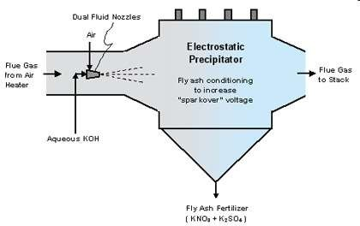
Electrostatic precipitator
Filtration device that removes fine particles like dust and smoke
Induced electrostatic charge
To avoid formation of
Nitrogen Oxide
Sulfur Oxide
Hydrogen Chloride
Apply energy to particulate material
& efficient in energy consumption

Slide 34
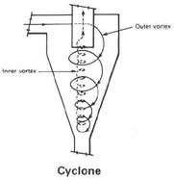
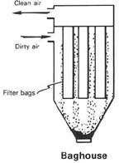
Bag house filter/cyclone separator
Fabric dust collector/ Fabric filters
Use principle of Inertia (centrifugal force)
Remove larger pieces of particulate matter

Slide 35
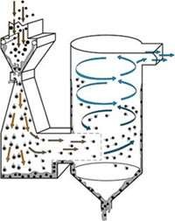
Wet scrubber
Apply energy directly to flowing fluid medium
Remove dust particles by capturing in liquid droplets
Scrubbing reagents such as lime and sodium hydroxide

Slide 36
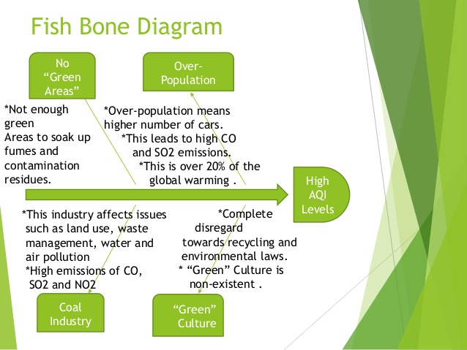

Slide 37
Benzene
Benzene was discovered by Michael Faraday in 1825
It is an aromatic hydrocarbon compound
Also referred to as phenol, benzol, phenyl hydride
Chemical formula C6H6

Slide 38
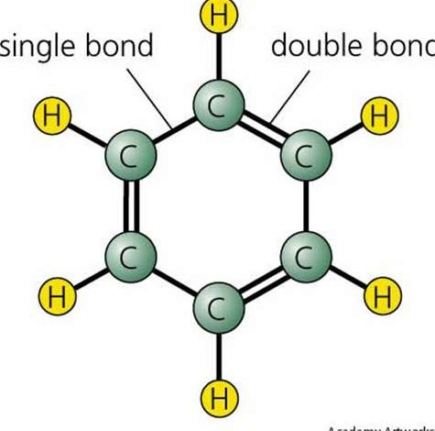
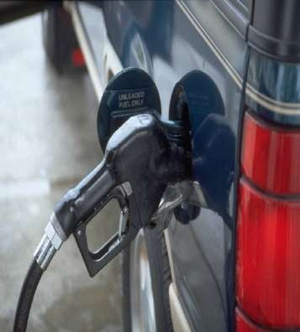
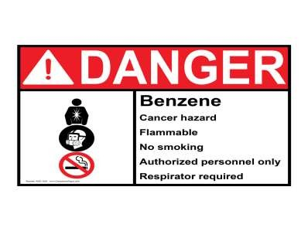
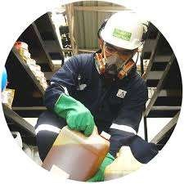
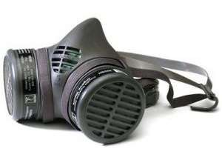
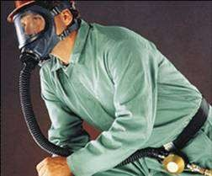

Slide 39
SOURCES and USES
SOURCE
A natural component of crude oil & refined petroleum
It is sometimes emitted from volcanoes
present in tobacco smoke & forest fires
USE
As a solvent in extraction of other substances
In the manufacture of plastics, resins, nylon, synthetic fibres, lubricants, dyes, detergents, drugs, pesticides

Slide 40
Sources of Exposure
OUTDOORS
Burning coal & crude oil
Ambient air around waste site
Gas stations & motor vehicle exhaust fumes
Industrial emissions
Petrol vapour
Tobacco smoke inhalation

Slide 41
Sources of Exposure
INDOORS
Tobacco smoke
Industrial use of benzene
Air from benzene containing products ( glue, paint, wax, detergents )

Slide 42
SYMPTOMS OF BENZENE EXPOSURE
INHALATION SYMPTOMS:
Irritated nose and throat, sneezing, coughing, drowsiness, dizziness, confusion, tremors, unconsciousness, headaches, euphoria, rapid and irregular heart beat, vascular congestion in brain, congestive gastritis, kidney congestion
death
INGESTION SYMPTOMS:
Vomiting, causing aspiration, breathing problems and coughing, irritation of the stomach, toxic gastritis dizziness, sleepiness, convulsions, rapid and irregular heart beat (Lower levels (700–3,000 ppm)
Death (Brief exposure (5–10 minutes) to very high levels of benzene in air (10,000–20,000 ppm) )

Slide 43
Exposure to Benzene Effects
Severity of effects is dependent on amount, route and length of exposure time, age and pre existing medical condition of the person exposed.
Damage to both humoral and cellular components of the immune system can occur in humans following inhalation exposure
Damage the immune system by altering antibody blood levels

Slide 44
Long Term Exposure to Benzene
Exposure of a year or more can cause:
Harmful effects on the bone marrow resulting in aplastic anaemia
excessive bleeding
Cancers e.g. blood cancer
Weakening of the immune system, making one susceptible to infection
Irregular menstrual periods in women & decreased
size of ovaries
Drying, red scaling of the skin (dermatitis)
memory loss, difficulty in sleeping neuropathy

